Slide 1
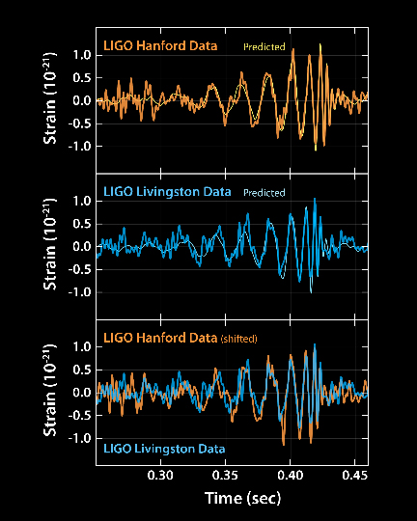

Gravitational Waves and Prospects for Multimessenger Astronomy
Barry C Barish
Caltech
for the
LIGO Scientific Collaboration
and
Virgo Collaboration
IceCube Particle Astrophysics Symposium 2017

Slide 2
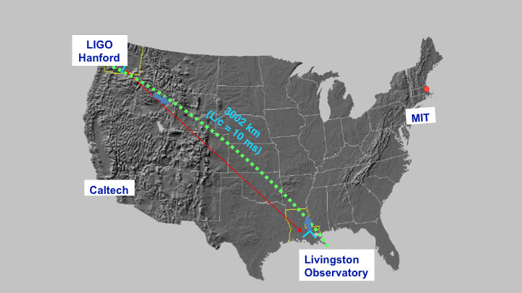
Siting LIGO
LIGO Sites

Slide 3
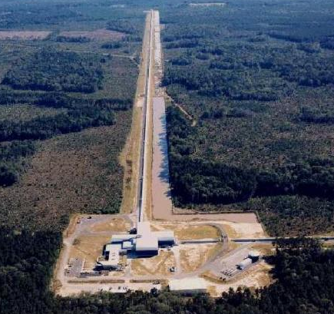
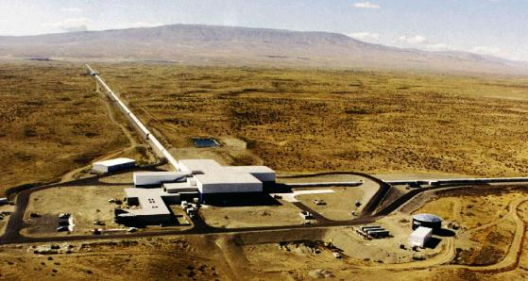
Hanford, WA
LIGO Interferometers
Livingston, LA

Slide 4
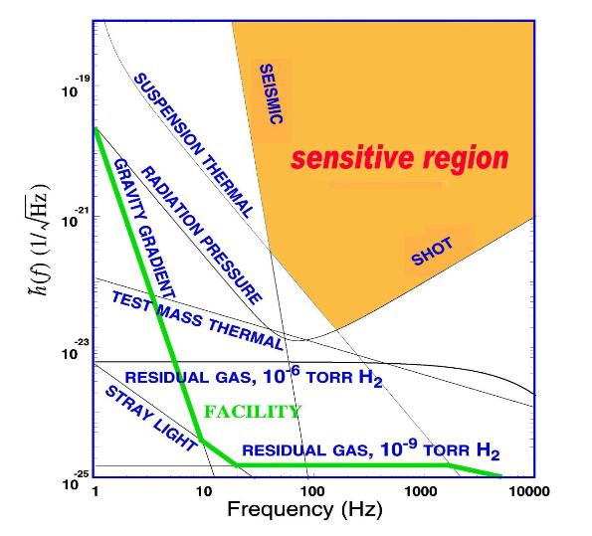
What Limits
LIGO Sensitivity?
Seismic noise limits low frequencies
Thermal Noise limits middle frequencies
Quantum nature of light (Shot Noise) limits high frequencies
Technical issues - alignment, electronics, acoustics, etc limit us before we reach these design goals

Slide 5
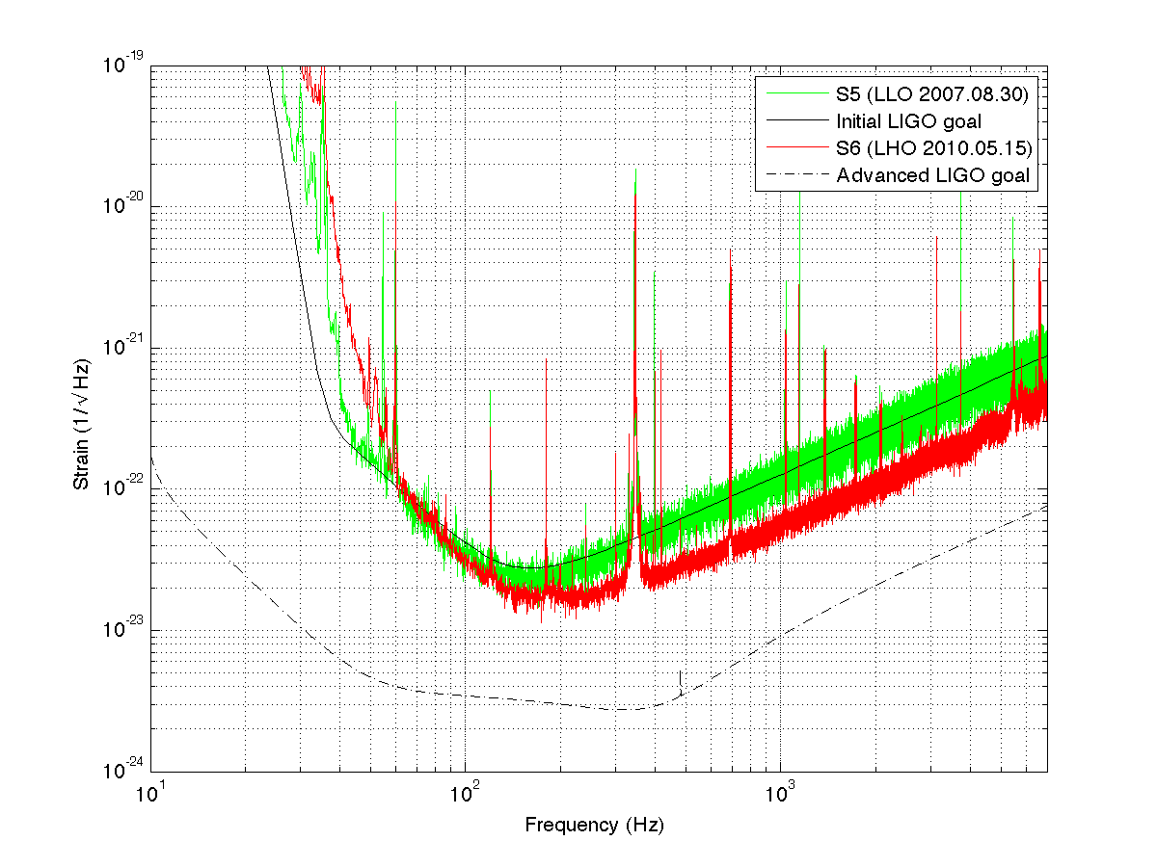
Advanced LIGO GOALS
GO
G
Better
seismic
isolation
Higher
power
laser
Better test
masses
and suspension

Slide 6
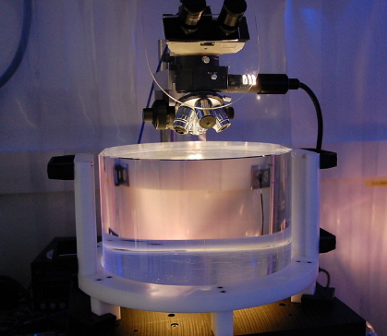
Mirror / Test Masses
Mechanical requirements: bulk and coating thermal noise, high resonant frequency
Optical requirements: figure, scatter, homogeneity, bulk and coating absorption
40 kg
Test Masses:
34cm φ x 20cm
Round-trip optical loss: 75 ppm max
40 kg
Compensation plates:
34cm φ x 10cm
BS:
37cm φ x 6cm
ITM
T = 1.4%

Slide 7
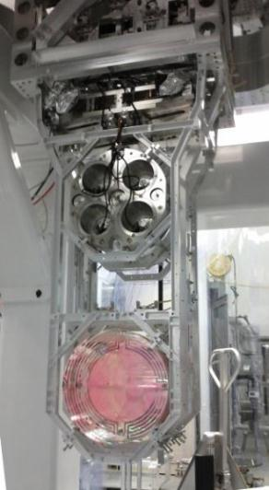

Test Mass
Quadruple Pendulum Suspension
Optics Table Interface
(Seismic Isolation System)
Damping Controls
Hierarchical Global
Controls
Final elements
All Fused silica
Electrostatic
Actuation

Slide 8
Seismic Isolation
Passive / Active Multi-Stage

Slide 9
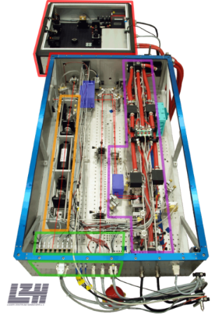
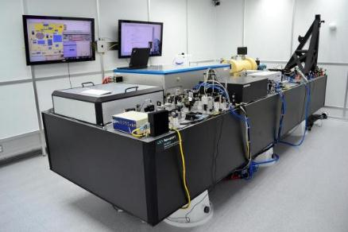
200W Nd:YAG laser
Designed and contributed by Max Planck Albert Einstein Institute
Stabilized in power and frequency
Uses a monolithic master oscillator followed by injection-locked rod amplifier

Slide 10
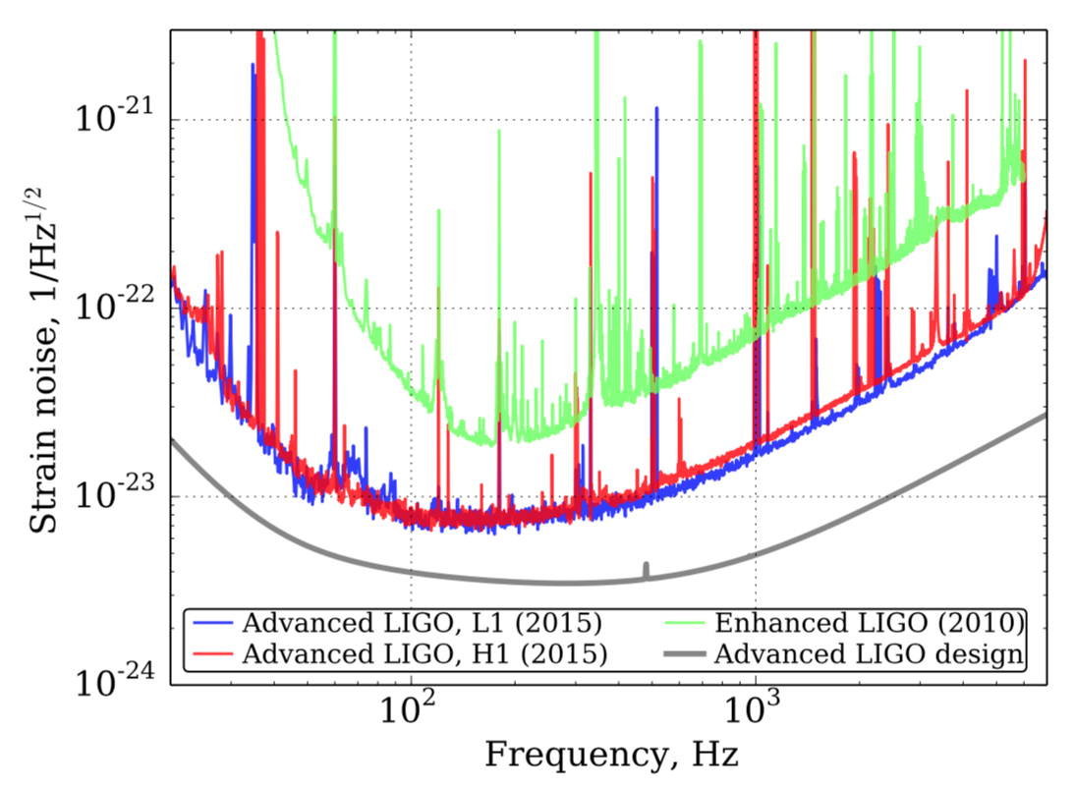
Sensitivity for first Observing run
At ~40 Hz, Factor ~100 improvement
Broadband,
Factor ~3 improvement
Initial LIGO
O1 aLIGO
Design aLIGO
Phys. Rev. D 93, 112004 (2016

Slide 11

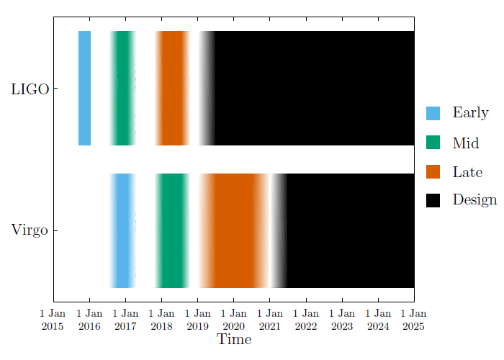
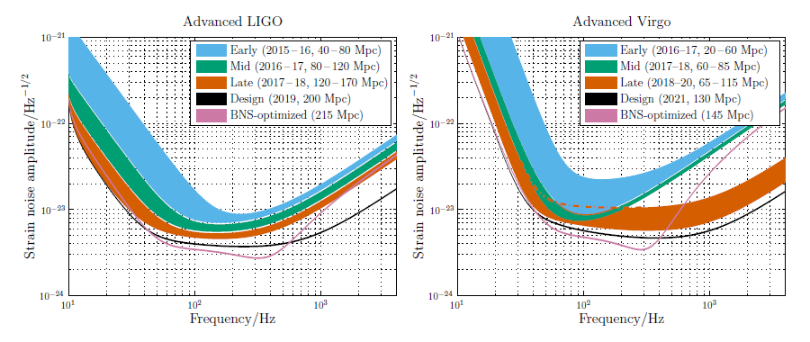
LIGO-Virgo Observing Plans
LIGO
Virgo
Living Rev. Relativity 19 (2016), 1

Slide 12
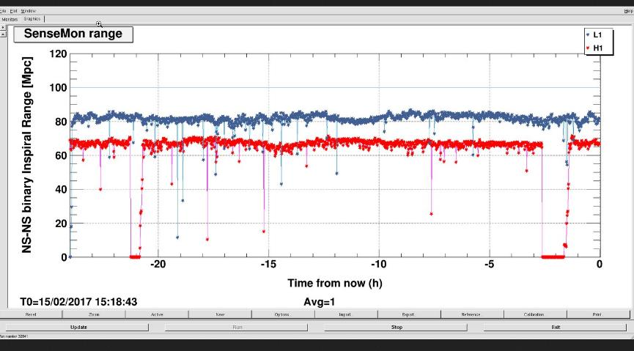
LIGO O2 Observational Run Underway

Slide 13
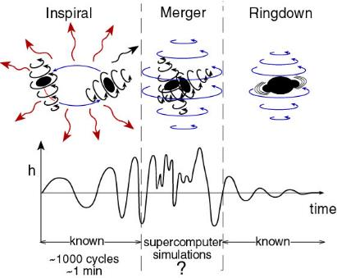
Compact Binary Collisions
  Neutron Star – Neutron Star
    waveforms are well described
  Black Hole – Black Hole
    Numerical Relativity waveforms
  Search: matched templates
“chirps”

Slide 14
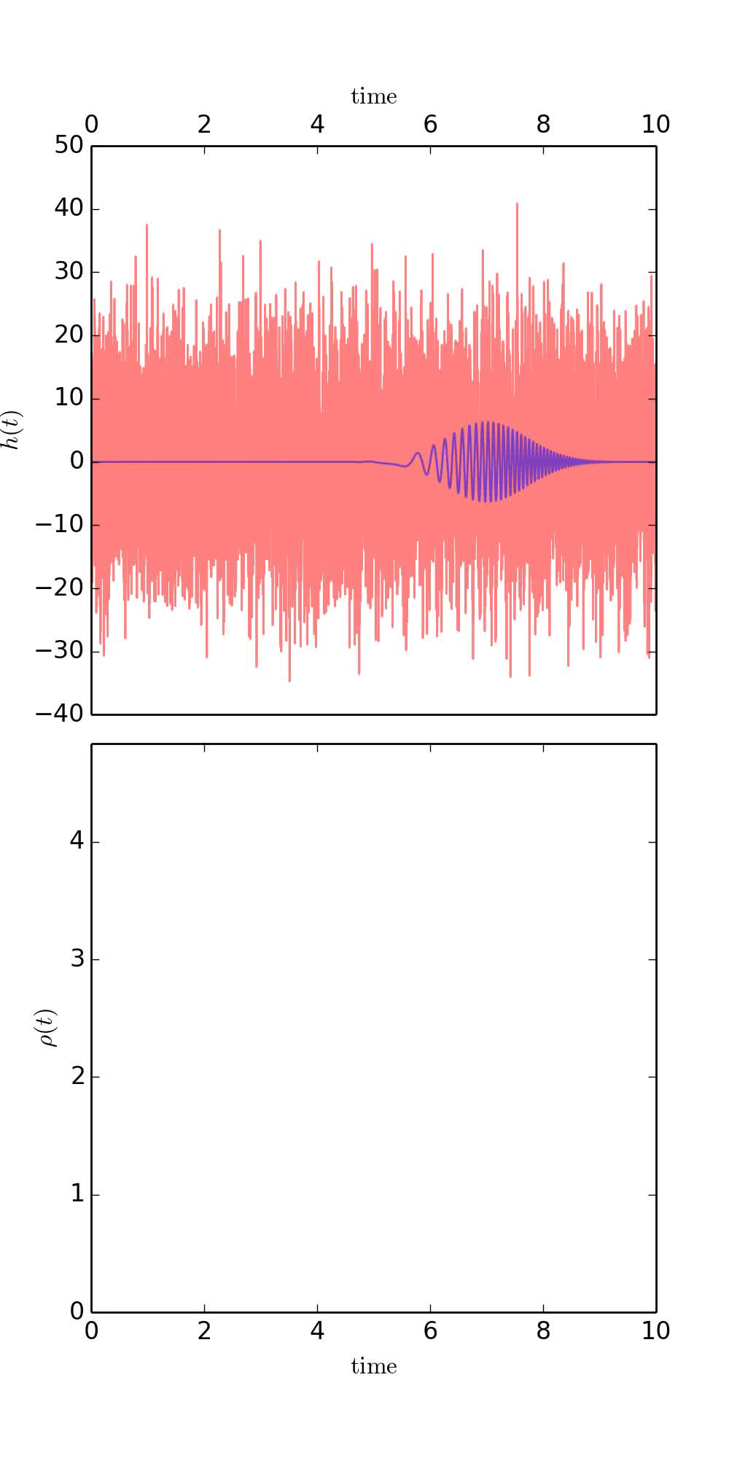
Finding a weak signal in noise
“Matched filtering” lets us find a weak signal submerged in noise.
For calculated signal waveforms, multiply the waveform by the data
Find signal from cumulative signal/noise
PHYS. REV. X 6,041015 (2016)

Slide 15
Image credit: LIGO
O1
Data Run

Slide 16
GW150914 – Black Hole Merger

Slide 17
Statistical Significance of GW150914
Binary Coalescence Search
Phys. Rev. Lett. 116, 061102 (2016)

Slide 18
GW151226 – Matched Filter

Slide 19
“Second Event” Inspiral and Merger GW151226
Phys. Rev. Lett. 116, 241103 (2016)

Slide 20
Measuring the parameters
Orbits decay due to emission of gravitational waves
  Leading order determined by “chirp mass”
  Next orders allow for measurement of mass ratio and spins
  We directly measure the red-shifted masses (1+z) m
  Amplitude inversely proportional to luminosity distance
Orbital precession occurs when spins are misaligned with orbital angular momentum – no evidence for precession.
Sky location, distance, binary orientation information extracted from time-delays and differences in observed amplitude and phase in the detectors

Slide 21

Black Hole Merger Parameters for GW150914
Use numerical simulations fits of black hole merger to determine parameters; determine total energy radiated in gravitational waves is 3.0$±0.5$ M_{o} c² . The system reached a peak ~3.6 x10⁵⁶ ergs, and the spin of the final black hole < 0.7 (not maximal spin)
Phys. Rev. Lett. 116, 241102 (2016)
Phys. Rev. Lett. 116, 061102 (2016)

Slide 22
Second Event, Plus another Candidate
PHYS. REV. X 6,041015 (2016)
Sept 2015 – Jan 2016 (4 months)

Slide 23
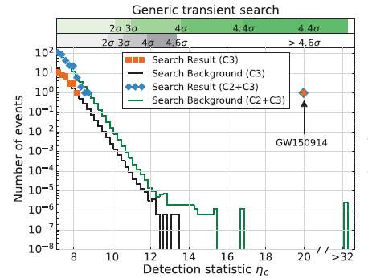
Note: Sharp Signal/Noise Boundary
Steep drop in false alarm rate versus size means edge of observable space is very sharp
Narrow time window lowers probability of noise triggers linearly
  Neutrino tri gger would help sensitivity a lot more than optical signals
O1 Burst Search

Slide 24
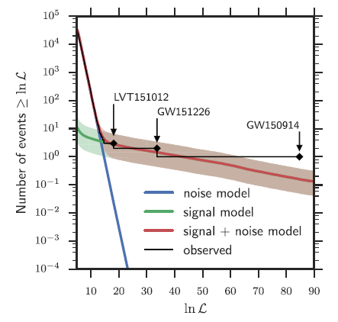
Signal to Noise for GW Events
O1 BBH Search
Important empirical feature
Very steep drop in false alarm rate for coincidence data!!

Slide 25
Final Black Hole Masses, Spins and Distance
PHYS. REV. X 6,041015 (2016)
PHYS. REV. X 6,041015 (2016)

Slide 26
Predicted Rates BNS and NSBH merger
arXiv:1607.07456
Left – Comparison of BNS merger rates and O1 low spin exclusion region (blue)
Right – Comparison of NSBH merger rates and O1 exclusion regions for 10-1.4 Solar masses (blues)

Slide 27
Localization LIGO O1 Events Simulated with Virgo

Slide 28


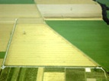



GW detector network by ~ 2025
Advanced LIGO
Hanford
2015
GEO600 (HF)
2011
KAGRA
2017
Advanced LIGO
Livingston
2015
Advanced
Virgo
2016
LIGO-India
2022
28

Slide 29
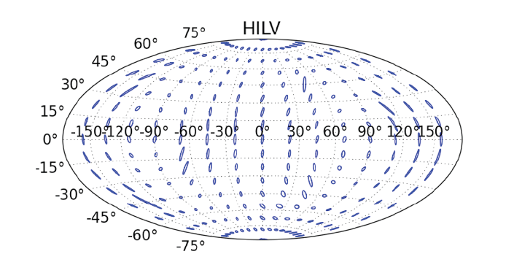
Localization Capability:
LIGO-Virgo plus LIGO-India
S. Fairhurst, “Improved source localization with
LIGO India”, J. Phys.: Conf. Ser. 484 012007

Slide 30
Thanks!

