Slide 1
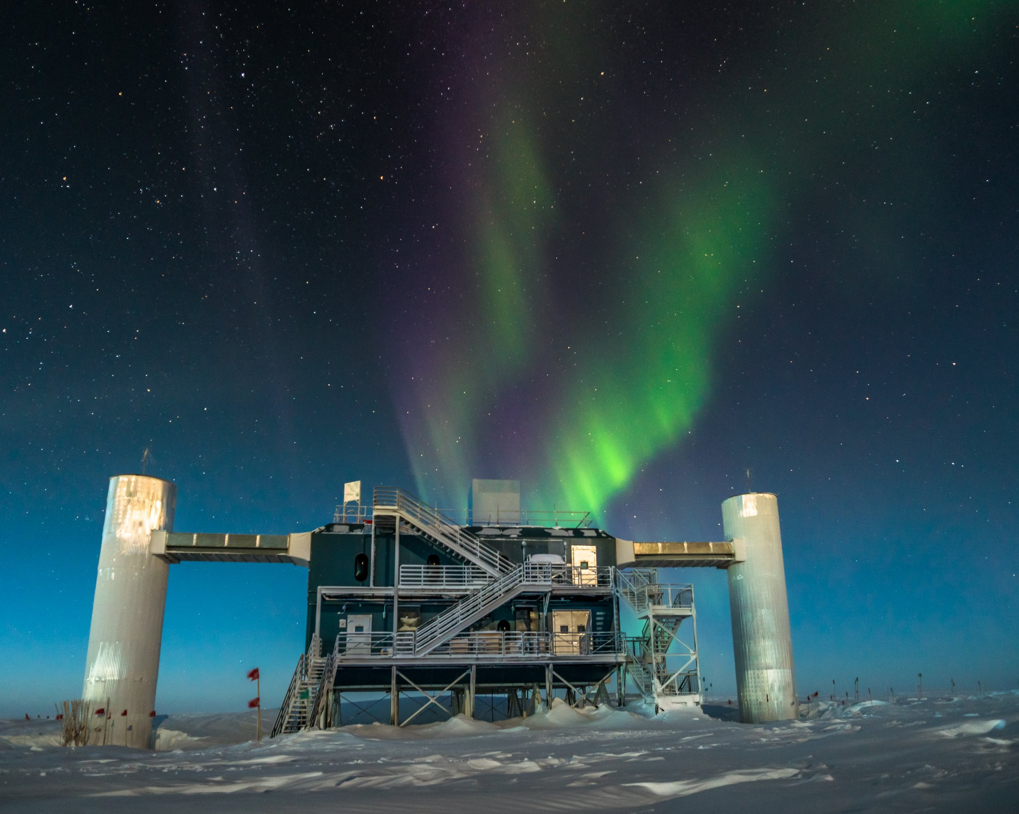
Recent Results from the
IceCube Neutrino Observatory
Chad Finley
Oskar Klein Centre
Stockholm University
IPA, Madison WI
2017 May 8
Photo: Martin Wolf

Slide 2
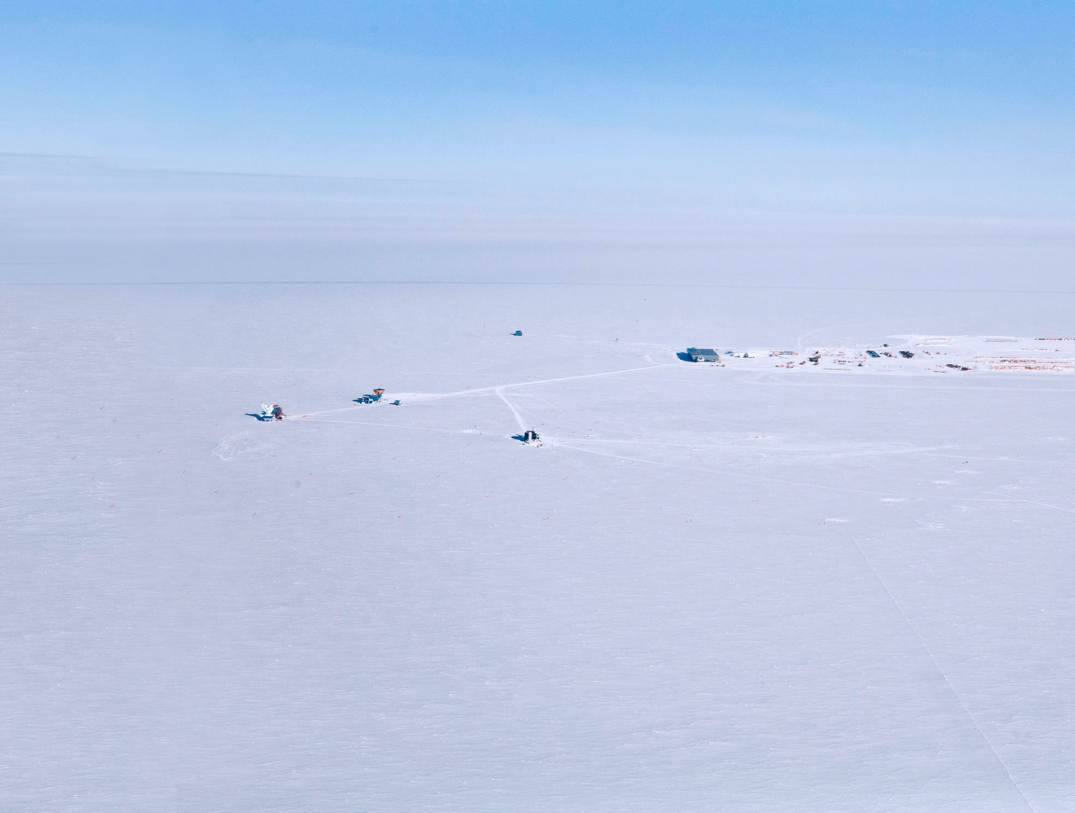
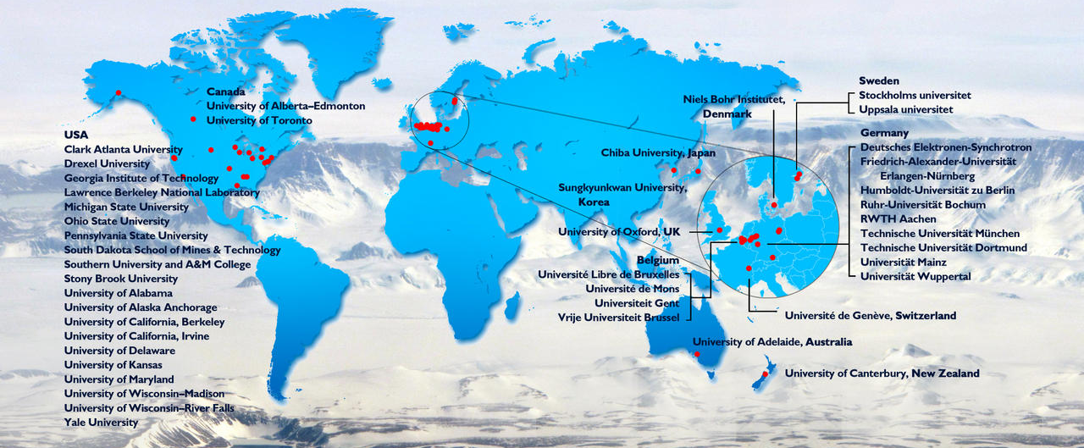
IceCube Collaboration
12 countries — 47 institutes — 300 scientists

Slide 3
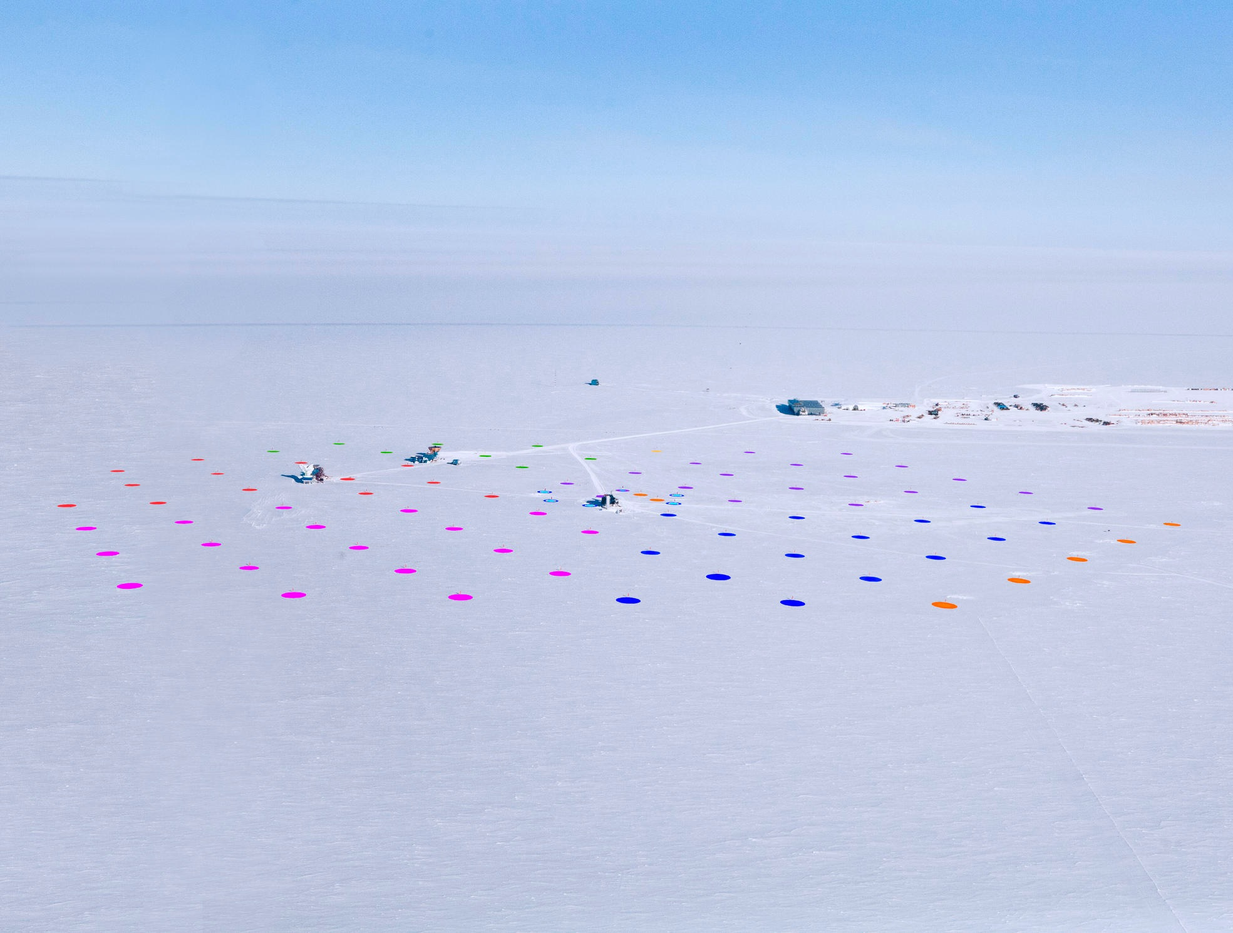
South Pole
Amundsen-Scott Station
IceCube Lab
IceCube
Neutrino Observatory
Photo: Haley Buffman

Slide 4
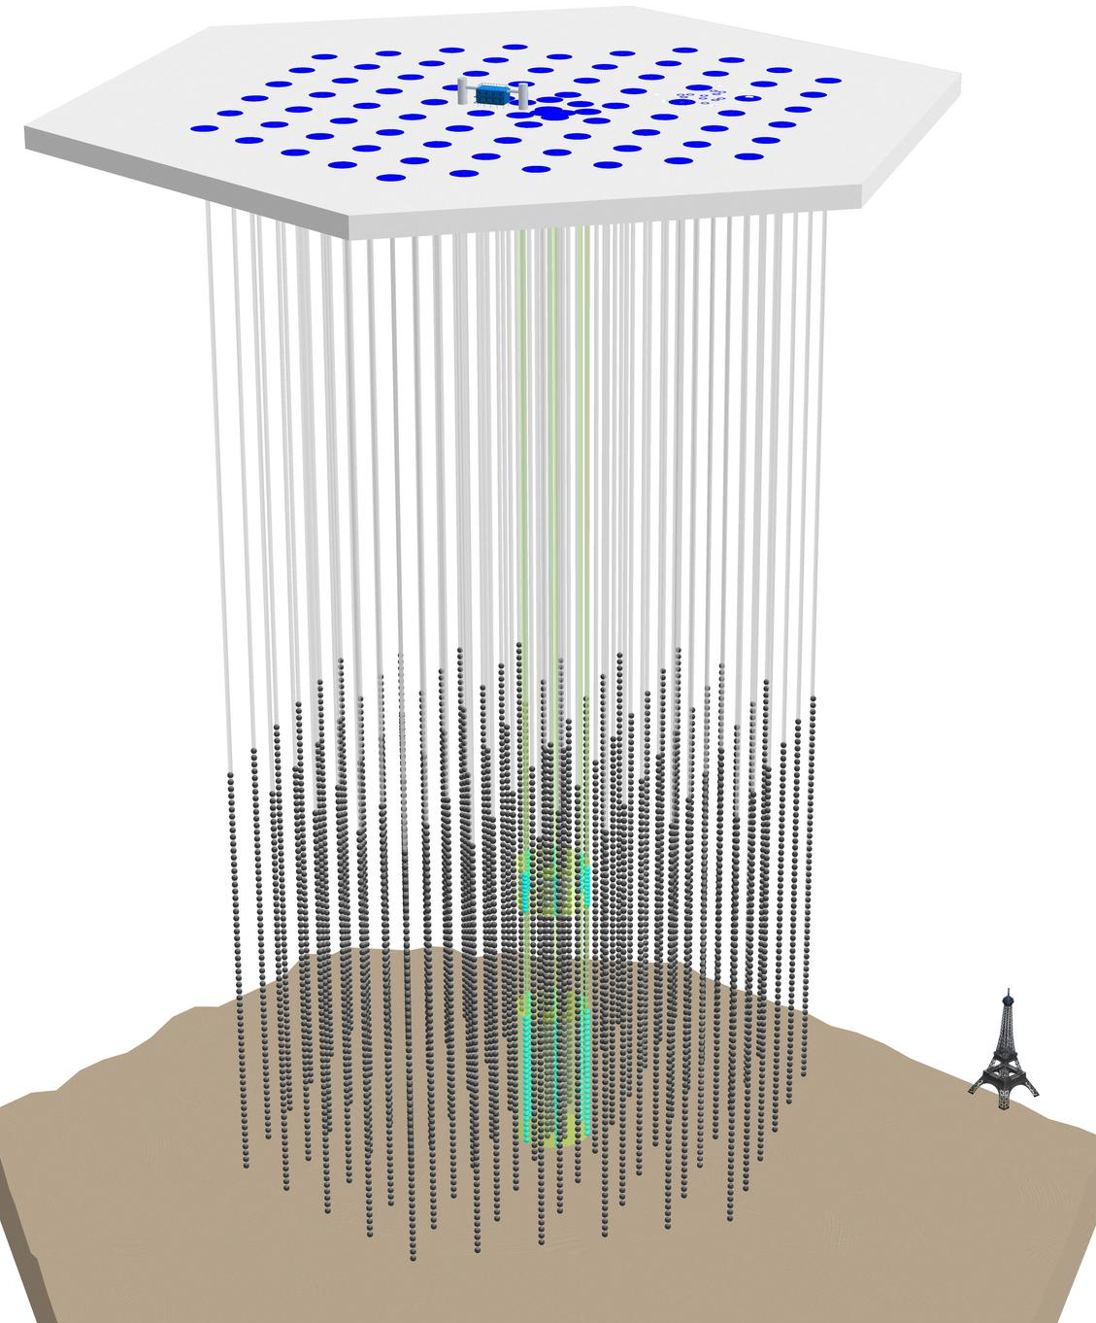
IceCube Neutrino Observatory
IceTop: 1 km² surface array
86 strings
60 Optical Modules per string
5 160 total modules in Ice
1 km³ = Gigaton instrumented volume
Began full operations May 2011
Highly stable operation.
Since 2014: livetime > 99%
clean-uptime 97-98%
(analysis-ready,
full-detector data)
2.5 km
DeepCore:
Low-energy Extension

Slide 5
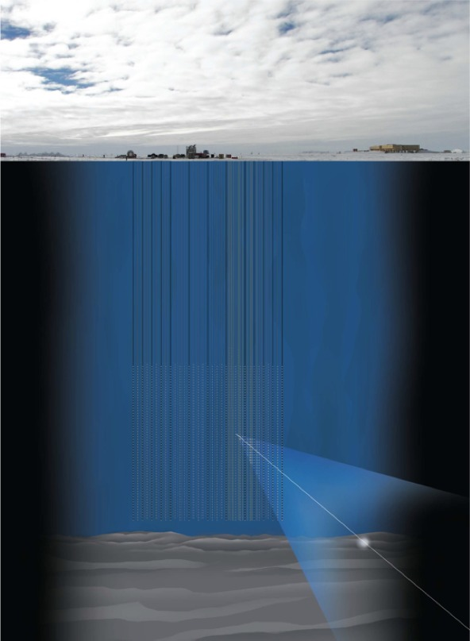
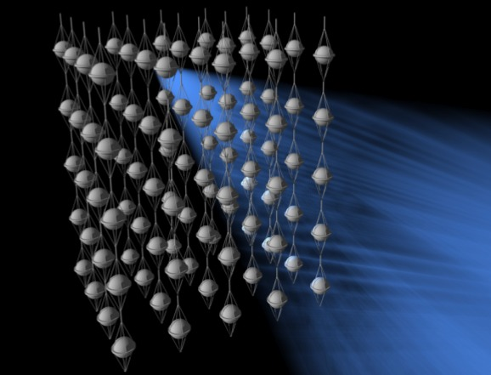
High Energy Neutrino Detection Principles
ν_{μ}
μ
W
N
X

Slide 6
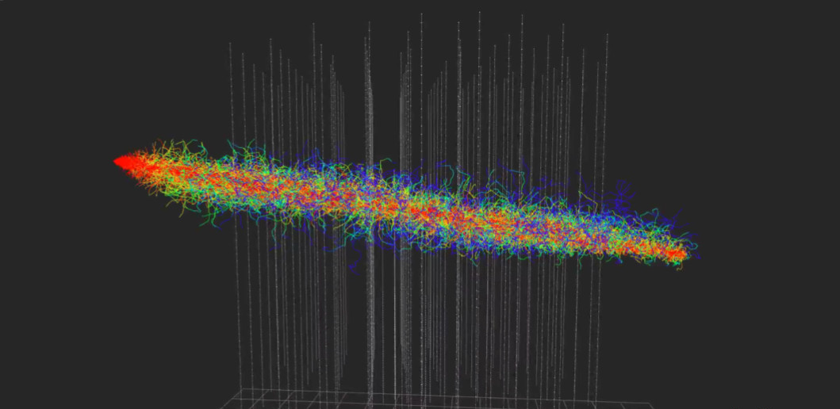
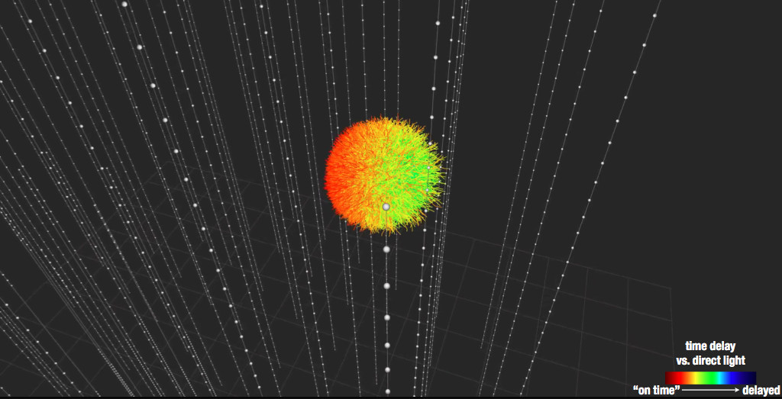
Photons produced by Neutrino Interactions
Track
topology
Energy measured:
lower bound
Good pointing:
0.2° - 1°
ν_{e} ν_{μ} ν_{τ} charged current
ν_{e} ν_{μ} ν_{τ} neutral current
Cascade topology
Good energy resolution, 15%
Some pointing,
10° - 15°

Slide 7
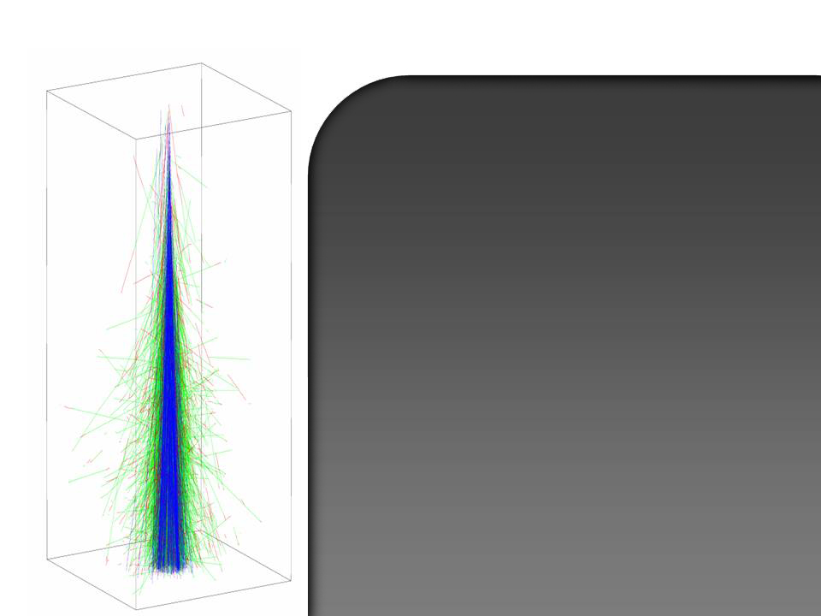
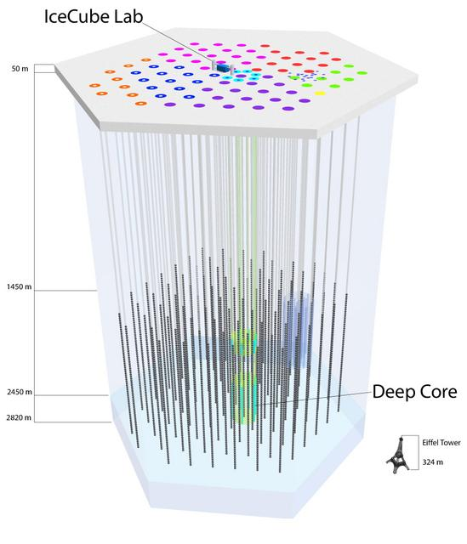
Cosmic Ray-induced events in IceCube
cosmic ray
air shower
astrophysical neutrino
atmospheric muons
atmospheric neutrinos

Slide 8
Cosmic Ray-induced events in IceCube
cosmic ray
air shower
Muon Bkg
astrophysical neutrino
Neutrino Bkg
atmospheric muons
10¹¹ / yr
northern sky
(filtered through Earth)
southern sky
(directly above detector)
atmospheric neutrinos
10⁵ / yr

Slide 9
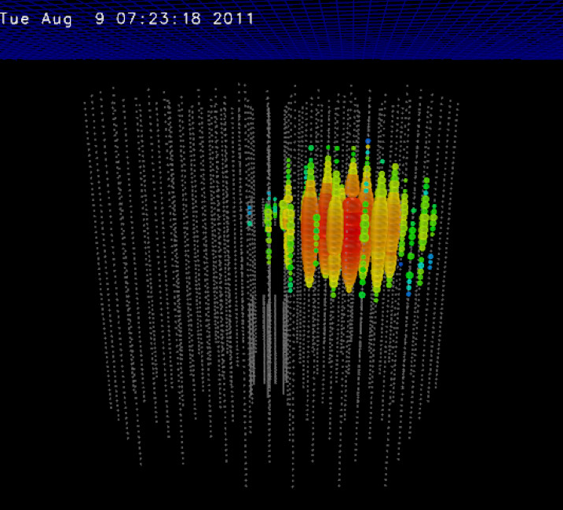
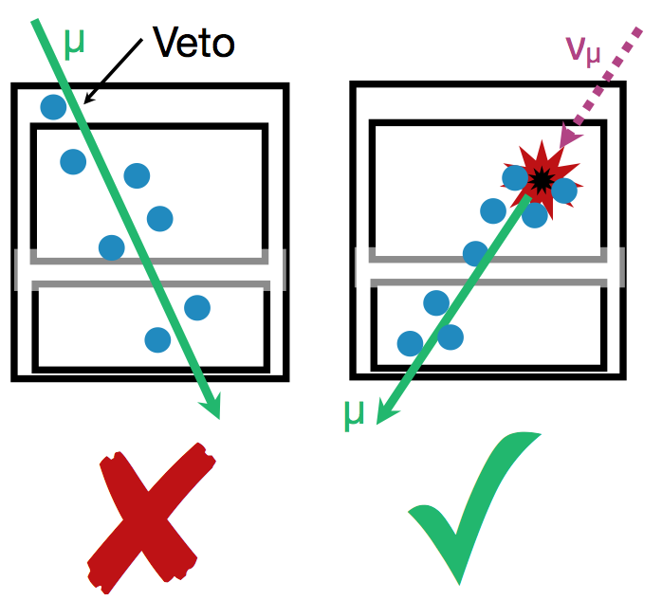
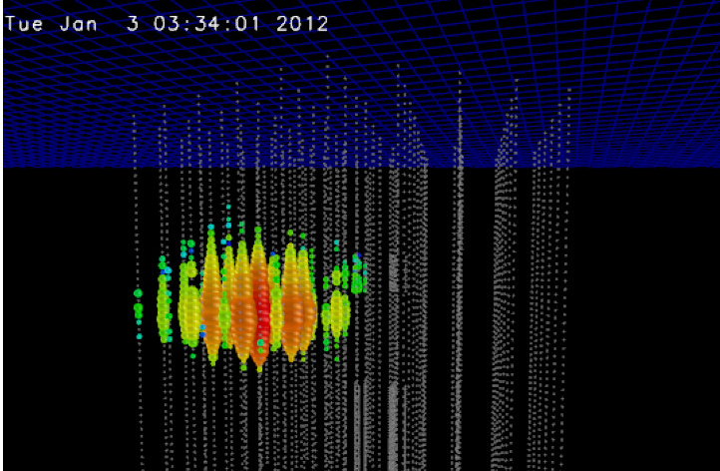
Starting Event Analyses
μ
ν_{μ}
“Bert”
1050 ± 140 TeV
PeV Events
“Ernie”
1150 ± 140 TeV

Slide 10
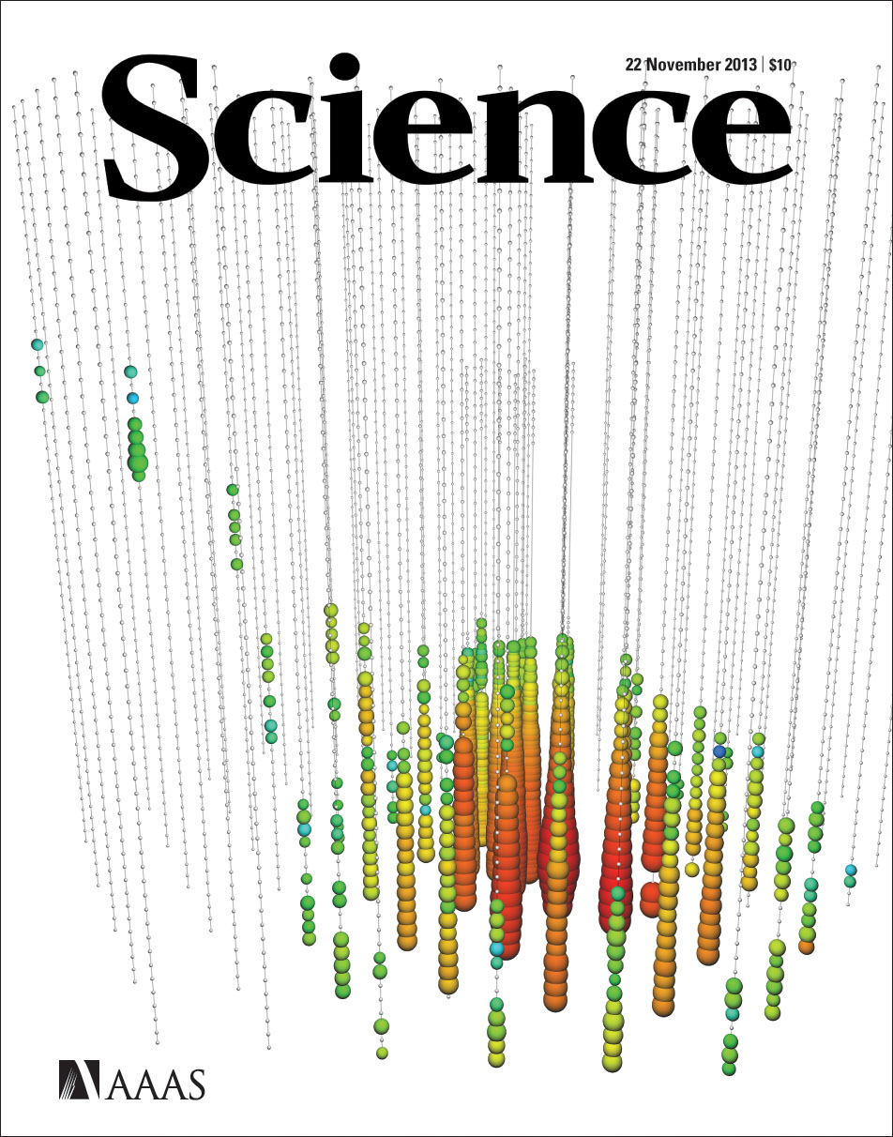
Starting Event Analyses
μ
ν_{μ}
“Bert”
1050 ± 140 TeV
PeV Events
HESE (High Energy
Starting Events):
Do not start in veto region
Have at least 6000 photoelectrons
“Ernie”
1150 ± 140 TeV

Slide 11
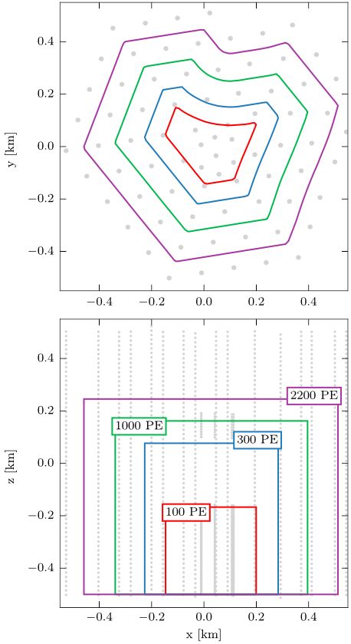
Medium Energy Starting Events
More sophisticated analysis:
Nested layering of vetoes
Lower-energy neutrinos retained if starting deep within detector
First 2-year analysis: 388 events
Both starting tracks and cascades
Best-fit: 87 ± 14 astrophys. neutrinos
PRD 91:022001 (2014)

Slide 12
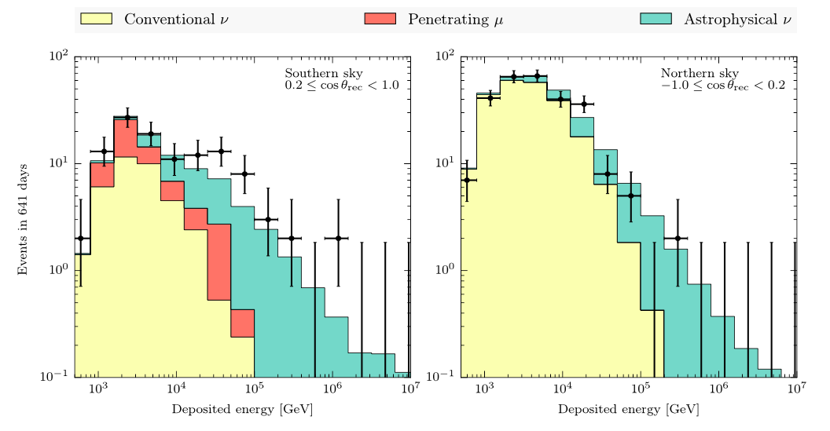
Medium Energy Starting Events
Best-fit astrophysical spectral index E^{-γ}: γ = 2.46 ± 0.12
For the neutrino energy range 20 TeV – 2 PeV

Slide 13
Muon Neutrino Diffuse Analysis
Complementary analysis to Starting Event analysis
Allow tracks to enter from outside detector
Use Earth as filter against muons from cosmic rays
muon neutrino analysis
ν_{μ} charged current
log₁₀ muon energy resolution ~ 0.3
(at energies ~ 100 TeV)
Good pointing: ~ 0.4°
ν
μ

Slide 14
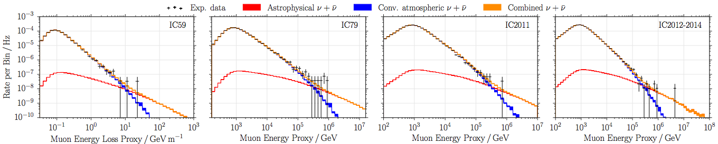
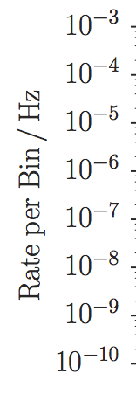
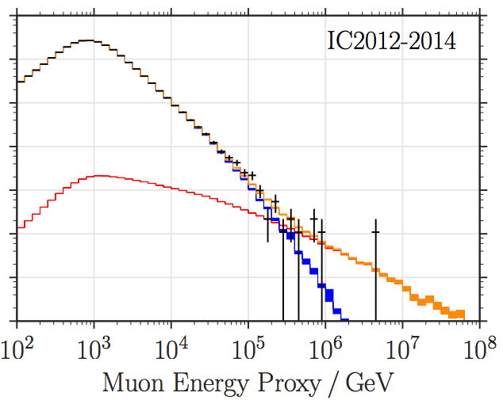
Diffuse Flux with Muon Neutrinos
Upgoing or Horizontal track =
Earth-filtered
350 000 events in 6-year analysis
Estimated 99.7% pure
muon-neutrino sample
5.6σ for astrophysical flux
Astrophys.J. 833 (2016) 1, 3

Slide 15
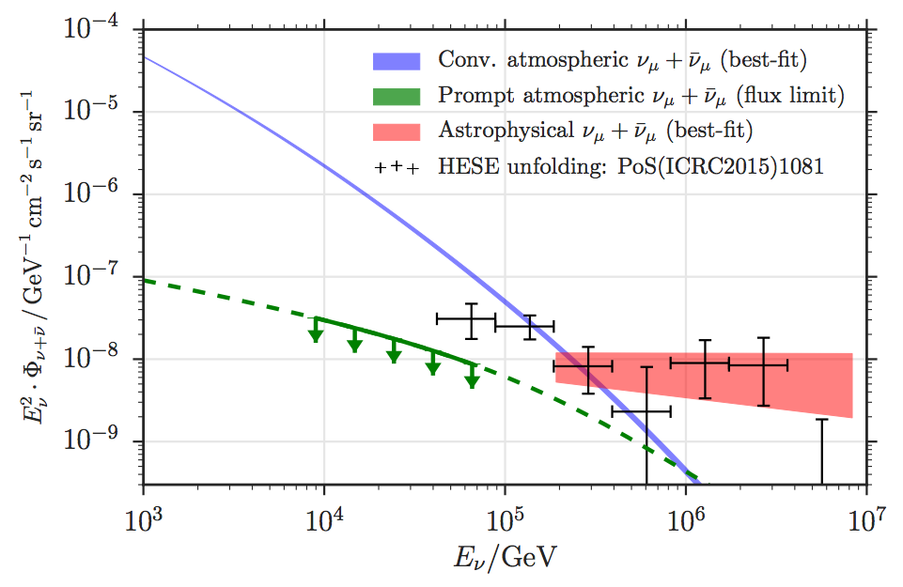
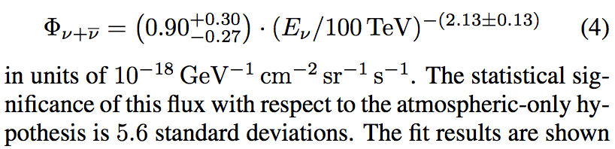
Diffuse Flux with Muon Neutrinos
Astrophys.J. 833 (2016) 1, 3
Fit the astrophysical neutrino flux
in the energy range 190 TeV – 8 PeV
Best fit:

Slide 16
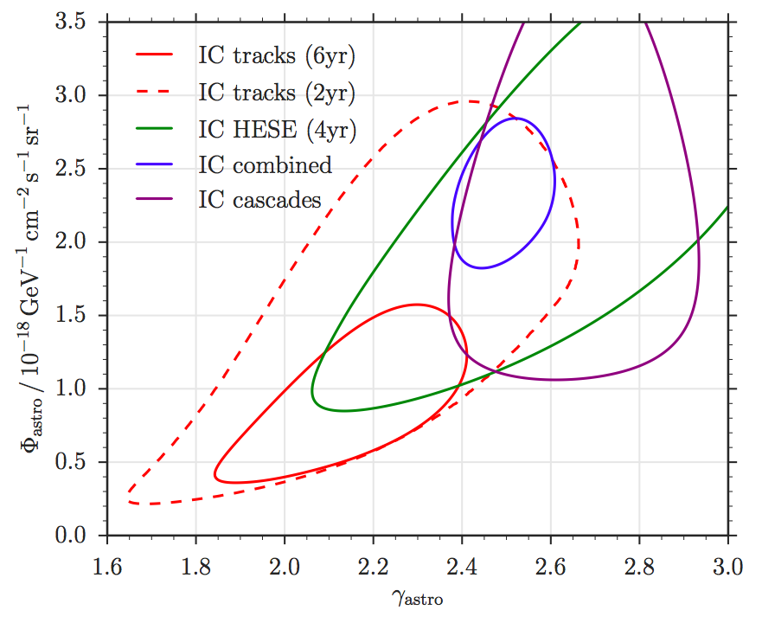
Energy Spectrum of Astrophysical Neutrinos
Analysis based primarily
on cascades:
γ = 2.5 ± 0.1
Based on northern sky
ν_{μ} tracks:
γ = 2.1 ± 0.1
3.3σ tension...
Could be: change in the power-law spectrum above 100 TeV...
Could be: softer component in southern sky due to galactic contribution...
Astrophys.J. 833 (2016) 1, 3
E>25 TeV
E>190 TeV

Slide 17
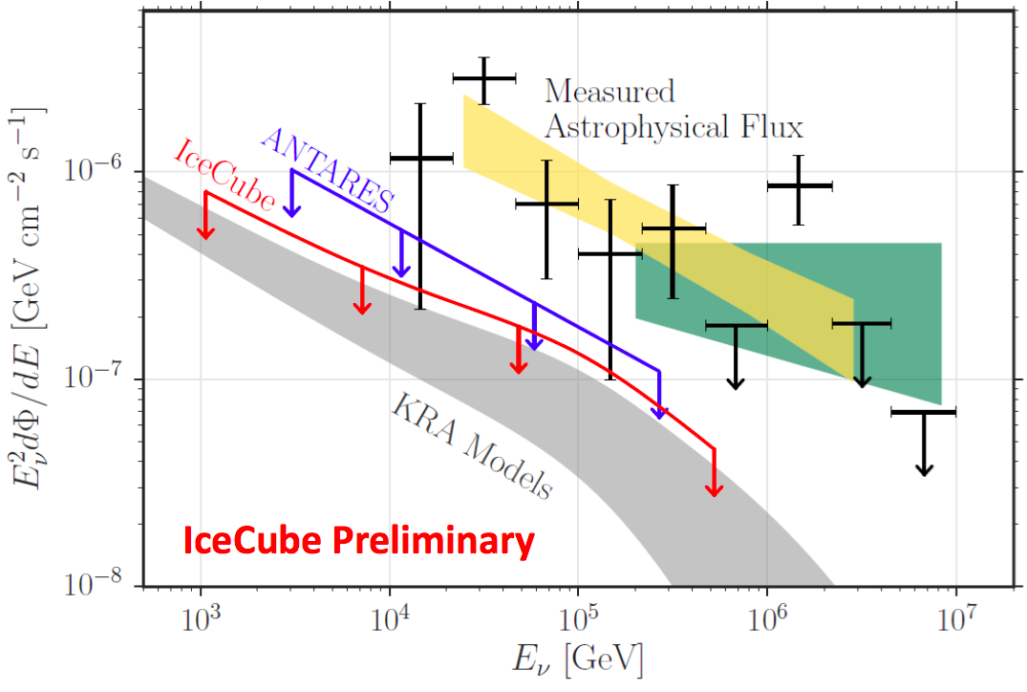
Galactic Plane Searches
Christian Haack, Jon Dumm, parallel session

Slide 18
Hundreds of astrophysical neutrinos, hidden in background of atm. neutrinos

Slide 19
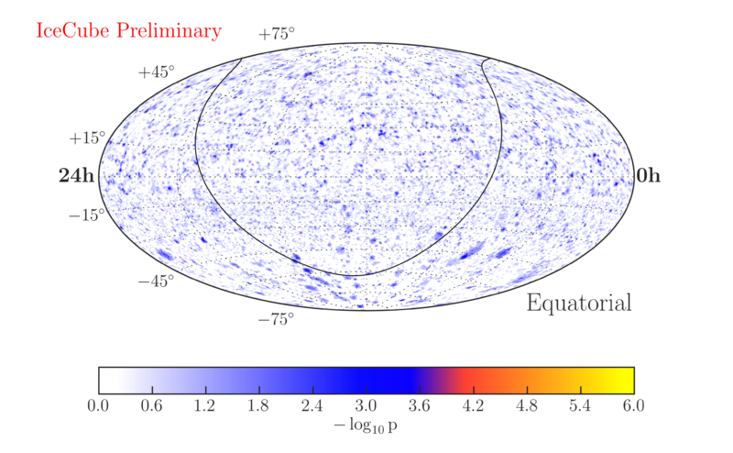
7-year Point Source Search
ApJ 835 (2017) 2, 151

Slide 20
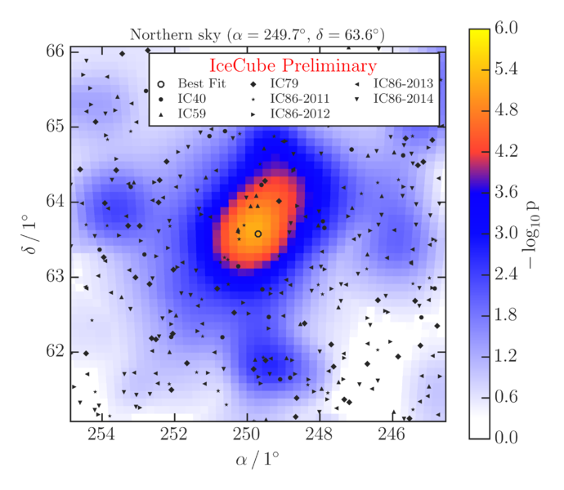
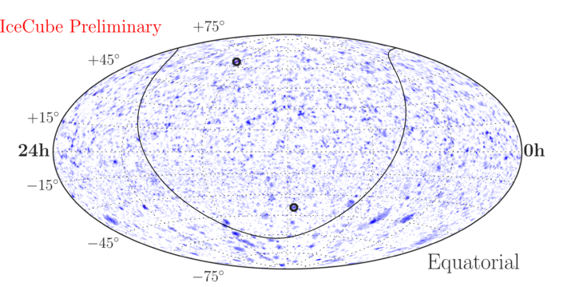
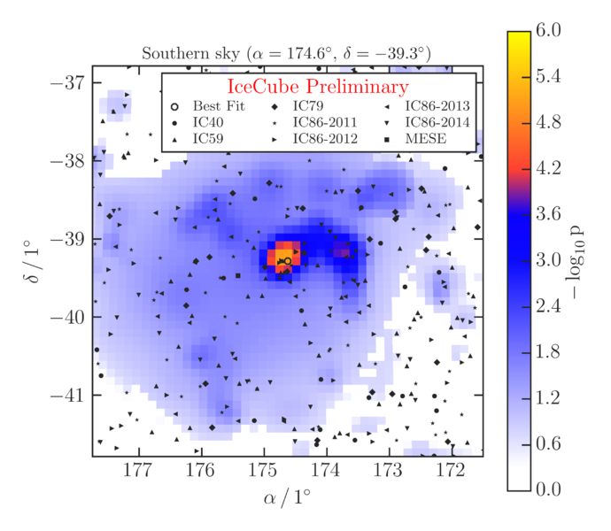
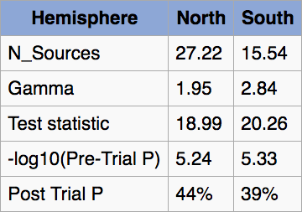
7-year Point Source Search
ApJ 835 (2017) 2, 151

Slide 21
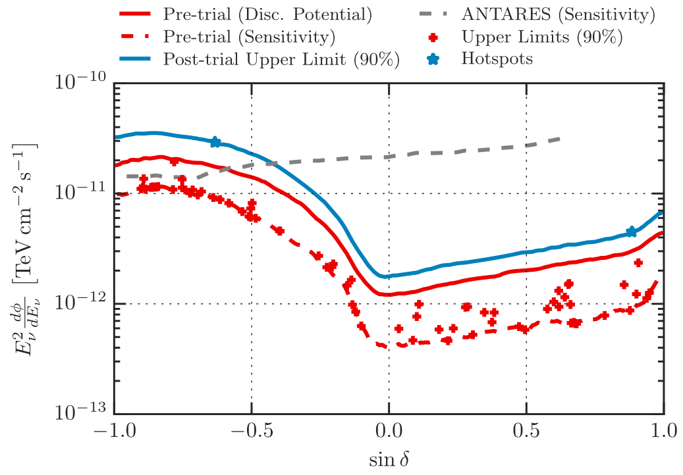
7-year Point Source Search
Southern sky
Northern sky
ApJ 835 (2017) 2, 151

Slide 22
Relating Diffuse and Point Source fluxes
Point-source equivalent flux if the diffuse astrophysical flux came from:
one point in the sky
100 points in the sky
1000 points in the sky
ApJ 835 (2017) 2, 151
Population studies with Stacking Searches

Slide 23
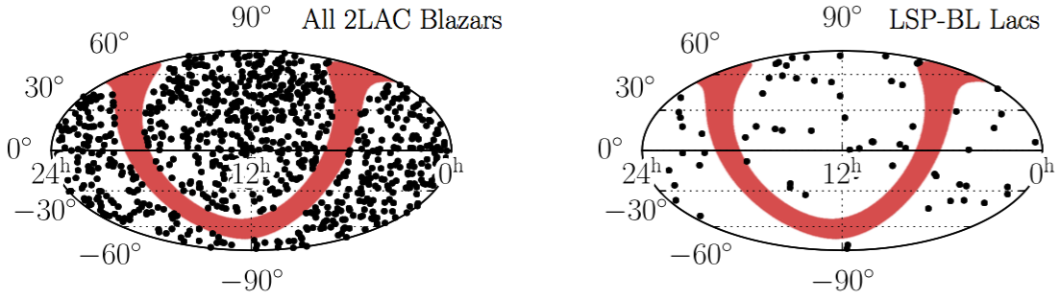
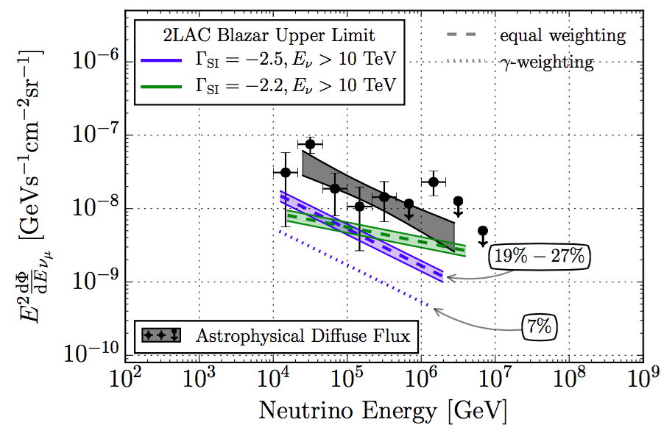
Point-Source Population Study: Blazars
Stacked Neutrino Point Source Search
using Fermi LAT catalog of 862 Blazars (active galactic nuclei whose jets point directly at us)
No significant excess seen
Total flux upper limit is below measured diffuse neutrino flux
Gamma-ray Bursts already excluded, < 1% of diffuse
astrophysical neutrino flux
ApJ vol. 835, no. 1, p. 45 (2017)

Slide 24
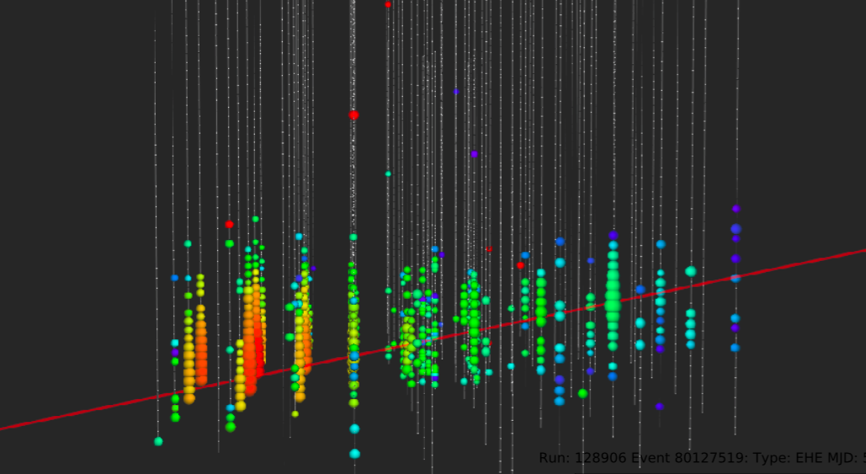
Realtime Public Alerts via AMON, GCN
Operating since April 2016 (second filter stream added during summer)
9 10 alerts in first year
Example event:
IceCube 161210A
r.a. 46.6 ± 1.0° (90% CL)
dec 15.0 ± 0.4° (90% CL)
Energy: ~ 100 TeV
Astrophysical signal probability: 49%
https://gcn.gsfc.nasa.gov/other/icecube_161210.gcn3

Slide 25
IceCube Realtime Alert System arXiv:1612.06028
10 alerts in first year
Expect (assuming E^{-2.6} spectrum): 3.5 signal + 5.6 bkg per year
Time from event at South Pole to public alert: < 1 min
For highly signal-like events, many follow-up observations reported:
  AGILE, ANTARES, FACT, Fermi-GBM, Fermi-LAT, HAWC, H.E.S.S., INTEGRAL, IPN, Konus-Wind, LCOGT, MAGIC, MASTER, Maxi/GSC, Pan-STARRS, PTF, Swift, VERITAS

Slide 26
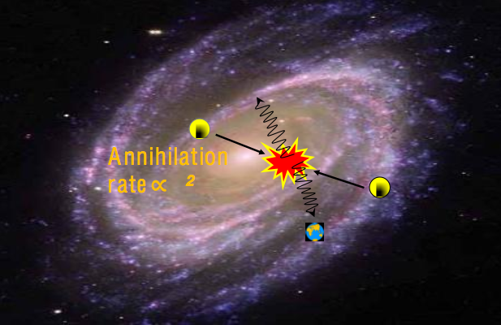
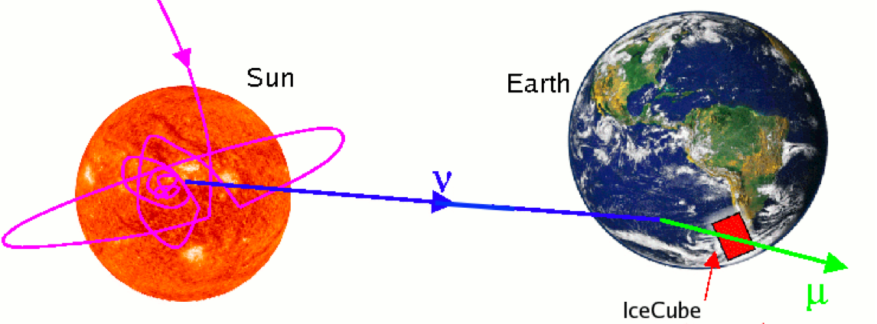
Indirect Dark Matter Searches
χ + χ → W + W → ν + ν
Neutrinos are typical end products of dark matter annihilation
Galactic Halo Searches:
Annihilation occurs in densest region of dark matter halo in galactic center
Search sensitive to annihilation cross section
Solar Searches:
Dark matter particles scatter and get trapped in sun.
As trapped density grows, annihilation rate reaches equilibrium with capture rate.
Search sensitive to scattering cross section
χ

Slide 27
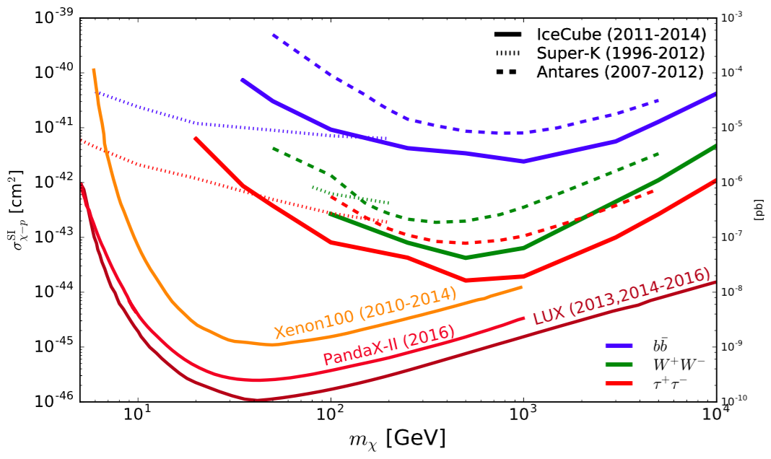
Spin Independent Scattering Cross Section Limits
Eur. Phys. J. C (2017) 77, 146

Slide 28
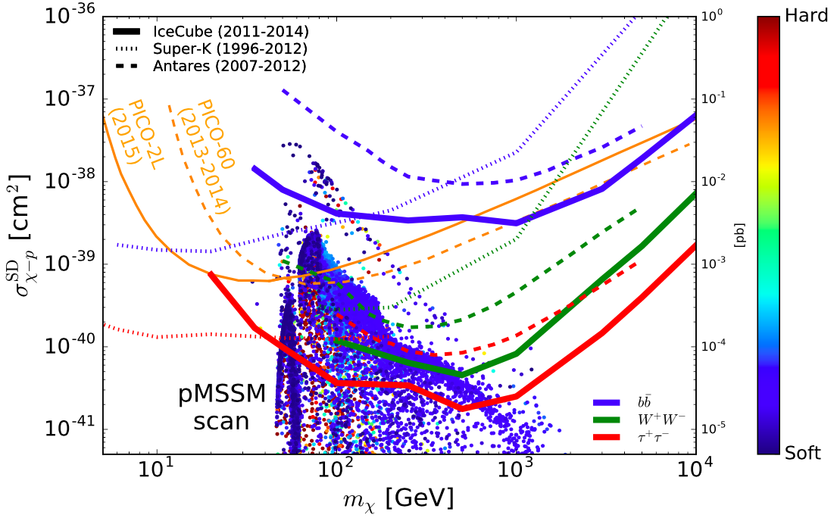
Spin Dependent Scattering Cross Section Limits
Eur. Phys. J. C (2017) 77, 146
Points correspond to models from a scan of the pMSSM, color coded by the ‘hardness’ of the resultant neutrino spectrum.

Slide 29
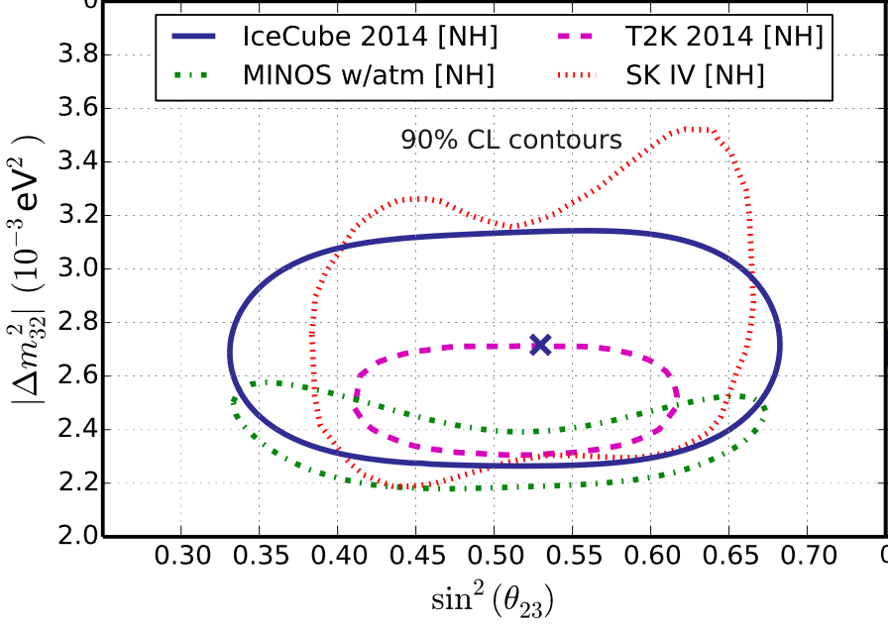
Neutrino Oscillations
3-year IceCube-Deepcore analysis Phys. Rev. D 91, 072004 (2015)

Slide 30
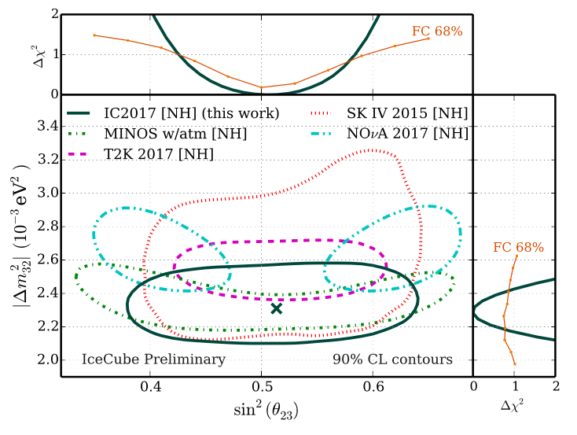
Neutrino Oscillations
IceCube Preliminary 90% CL contours
See parallel talk by João Pedro Athayde Marcondes de André and Joshua Hignight
Also 3-year analysis, but new event selection with 10x more events
Result still statistics limited

Slide 31
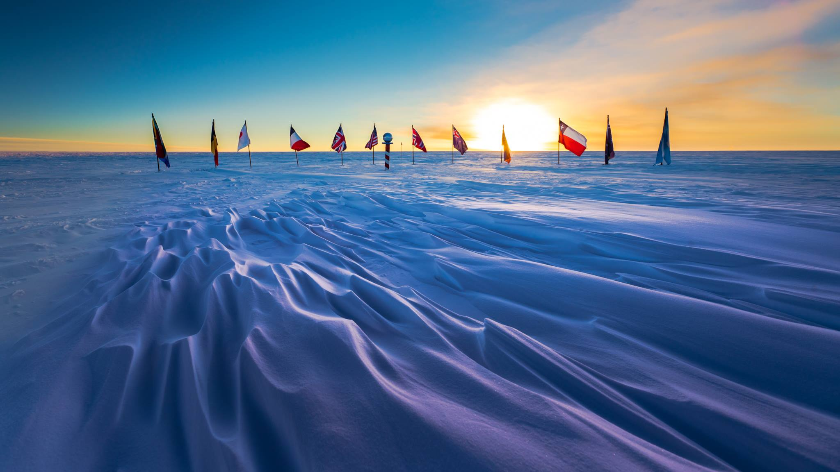
IceCube is entering 7th year since construction completion.
Extremely stable and high performance.
Continual improvements in event selection, reconstruction, and analysis. Leading and competitive results across diverse topics
Many more analyses being presented here at IPA:
Diffuse galactic emission, Fast radio bursts, Decaying dark matter, Tau neutrinos, Point-source searches with new track and cascade selections, ...
Photo: Martin Wolf

Slide 32
For the astrophysical neutrino flux:
New analyses of cascade events coming later this year:
2yr -> 6yr of data
improved: event selection, reconstruction, analysis
Un-broken power-law, or features in energy spectrum?
Signal from galactic plane will (eventually) be detected
Some models predict soon
Realtime alerts: telescope follow-up may identify first transient source

Slide 33
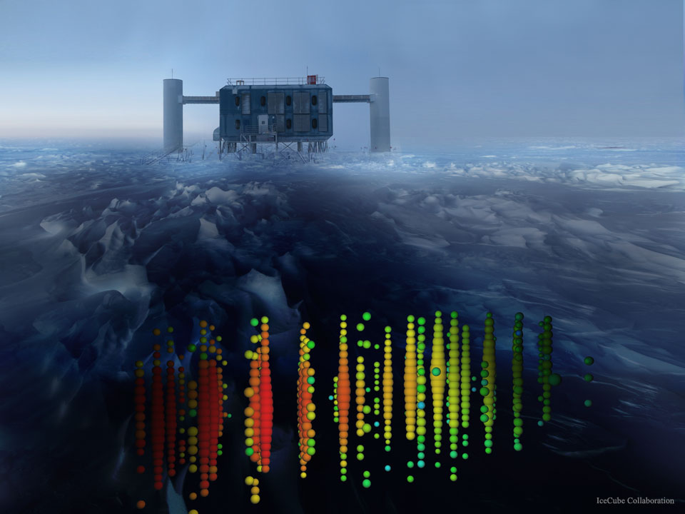
What IceCube cannot answer today...
IceCube Gen2 may answer tomorrow....
see M. Kowalski talk

