Slide 1
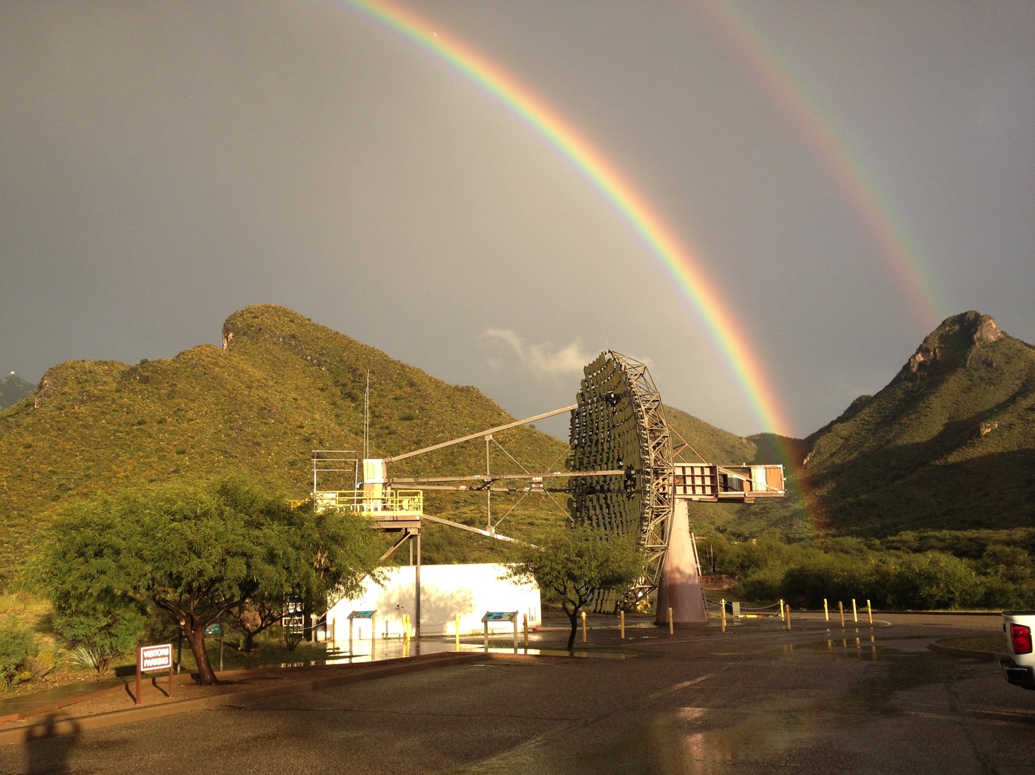

Slide 2




Imaging Atmospheric Cherenkov Telescopes: Present and Future.
Jamie Holder
Bartol Research Institute/Department of Physics and Astronomy
University of Delaware
IceCube Particle Astrophysics Symposium
Madison
May 9th, 2017

Slide 3
The Charge:
  “Your talk should be presented as a compact presentation of
  recent results and major open questions persisting in the field, with an emphasis on what can be done in the coming decade -experimentally, theoretically or both - to resolve these questions.”
  What tools will we use to resolve the questions?

Slide 4
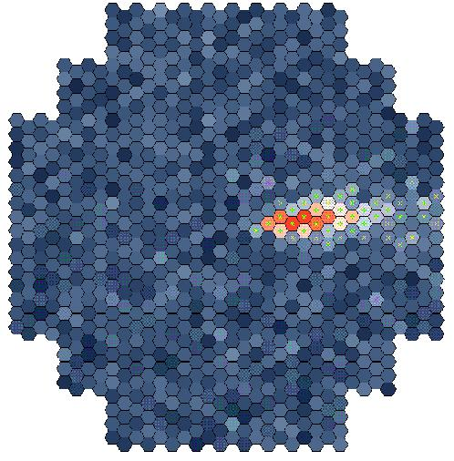
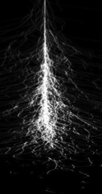
Notes:
A Megaton Calorimeter with Cherenkov readout
An area of 10⁵ m²

Slide 5
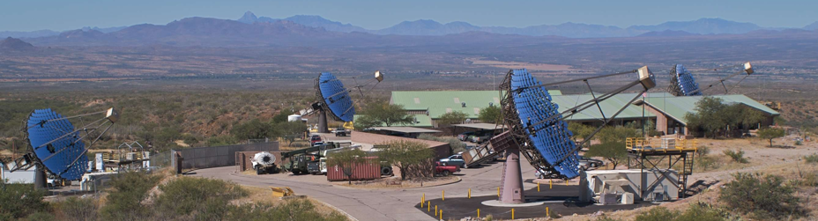

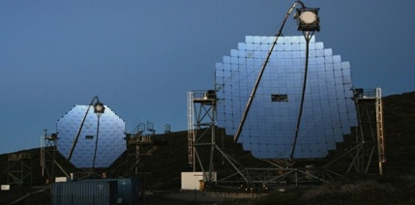
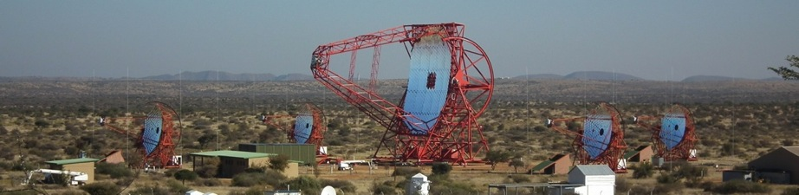
VERITAS
The Present
MAGIC II
H.E.S.S. II
H.E.S.S.

Slide 6
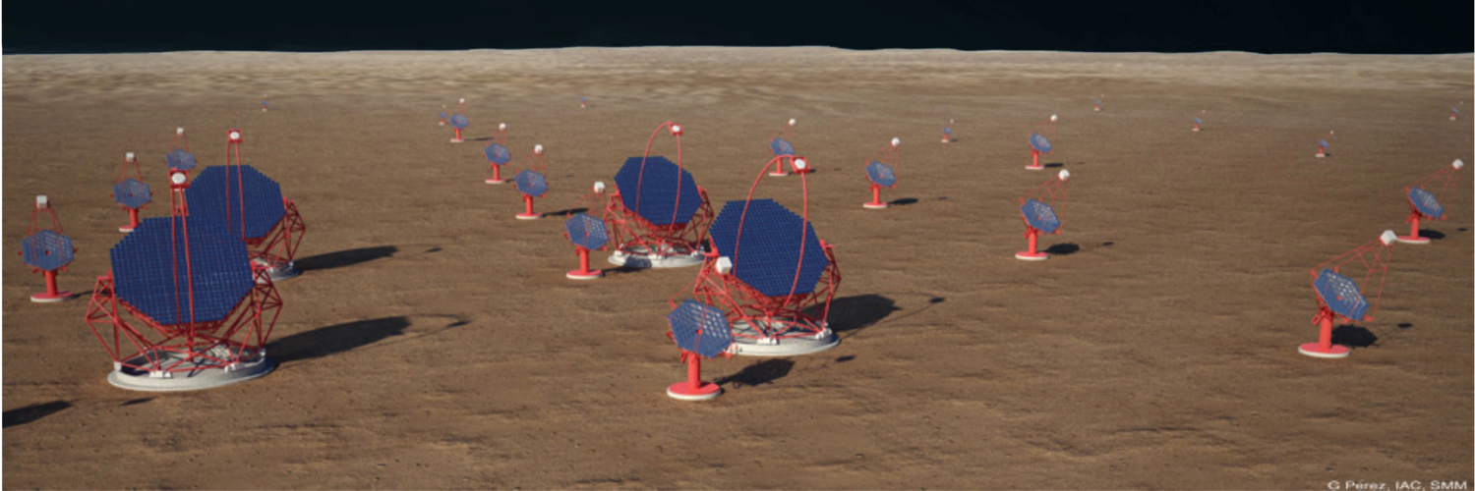
The Future: The Cherenkov Telescope Array
Low energies
Energy threshold 20-30 GeV
23 m diameter
4 telescopes (South)
4 telescopes (North)
Medium energies
100 GeV – 10 TeV
9.5 to 12 m diameter
25 medium-size telescopes (S)
15 medium-size telescopes (N)
High energies
10 km² effective area
4m diameter
70 small-size telescopes (S)
Notes:
Latest telescope counts are from https://portal.cta-observatory.org/SiteAssets/Pages/News/GCTFirstLight_08122015.pdf
Threshold for implementation:
LST 4 in N, 0 in S
MST/SCT 15 in S, 5 in N
SST 50 in S, 0 in N

Slide 7
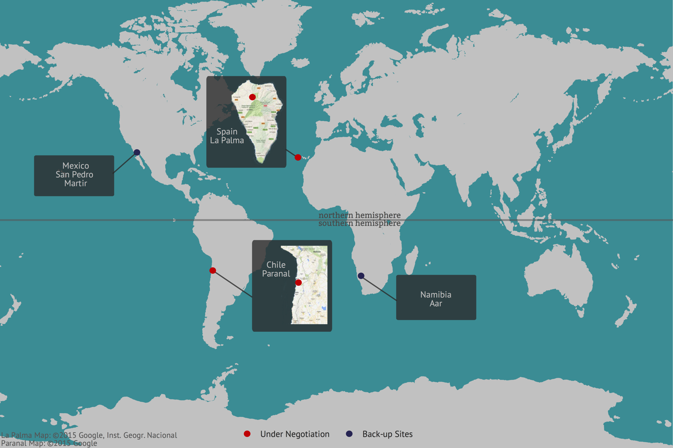

SITES

Slide 8
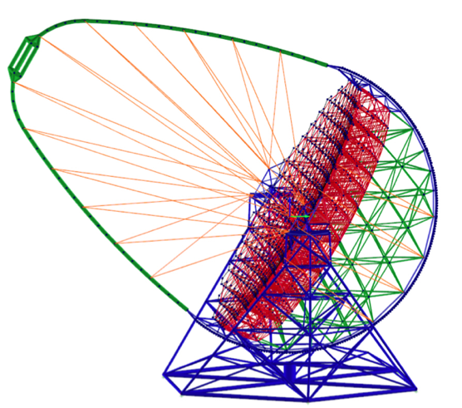
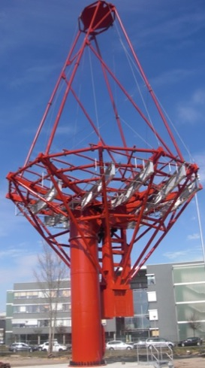
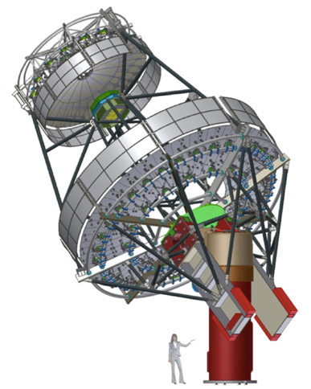
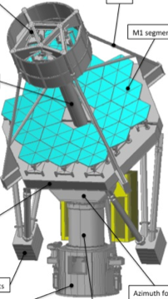
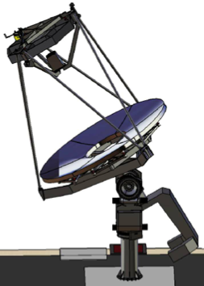
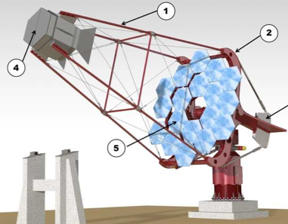
CTA Telescopes under development
Medium
~12m
Large
~23m
Medium-single
Medium-dual
Small
~4m
Small-dual (ASTRI)
Small-dual (GCT)
Small-single (SST-1M)
Notes:
Dustbin mirror
Subsequently 30” mirror, Pic du Midi

Slide 9
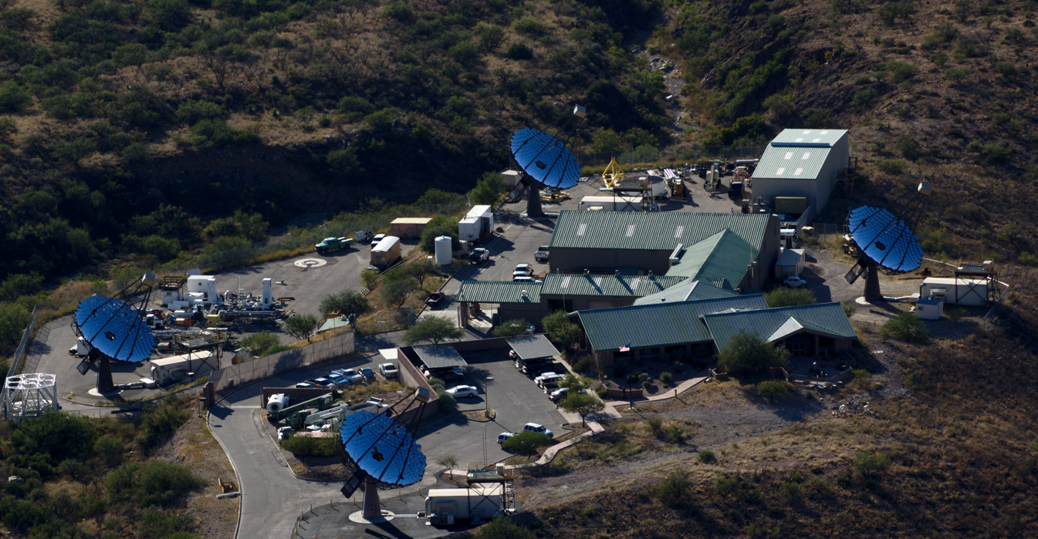
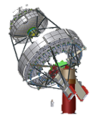

Slide 10
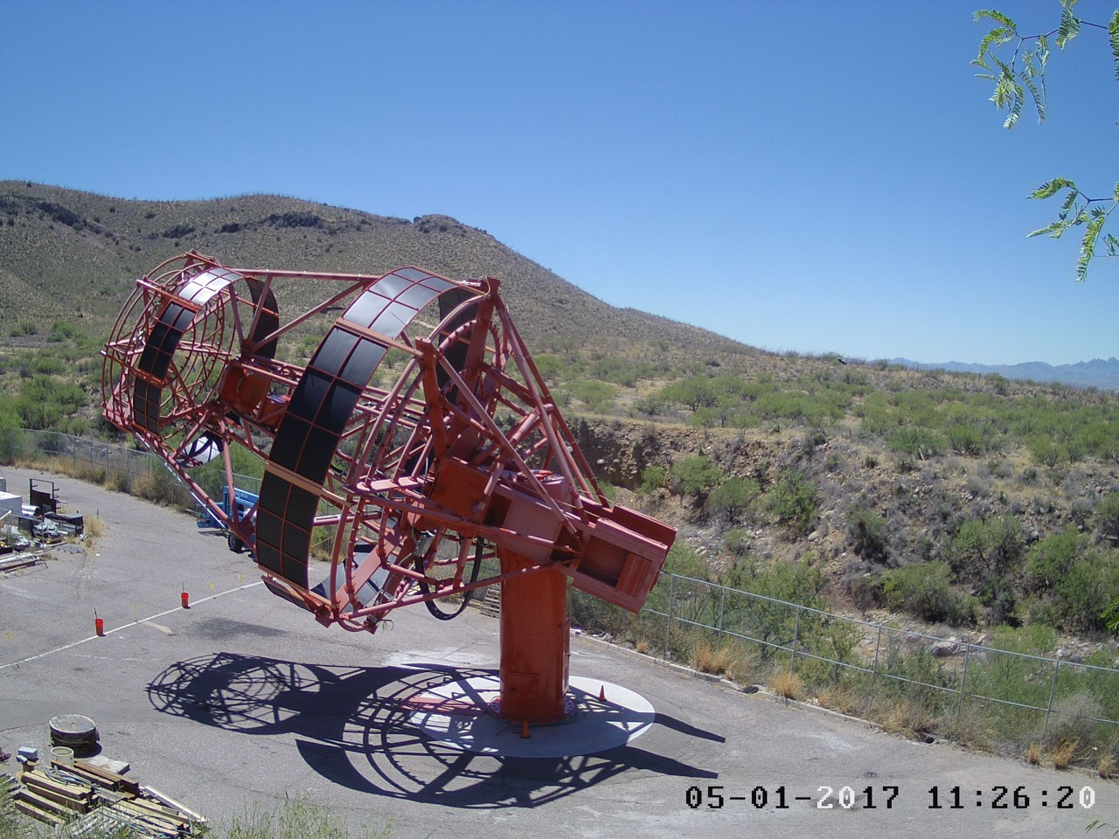

Slide 11
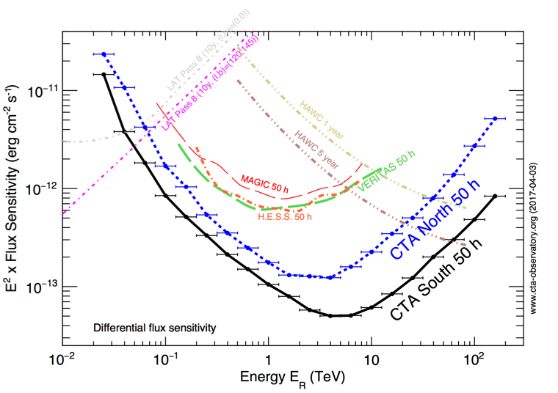
Present vs Future
Sensitivity improvement of an order of magnitude.
Energy range extended both higher and lower.
Improved angular (and energy) resolution.

Slide 12
The Charge:
  “Your talk should be presented as a compact presentation of
  recent results and major open questions persisting in the field, with an emphasis on what can be done in the coming decade -experimentally, theoretically or both - to resolve these questions.”
  What are the questions?
  Let’s start with just a few of the original ones…

Slide 13
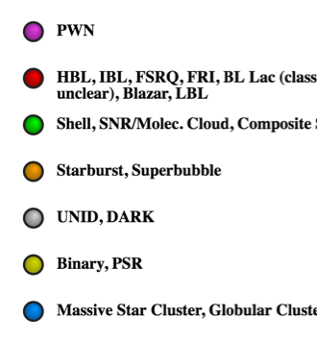
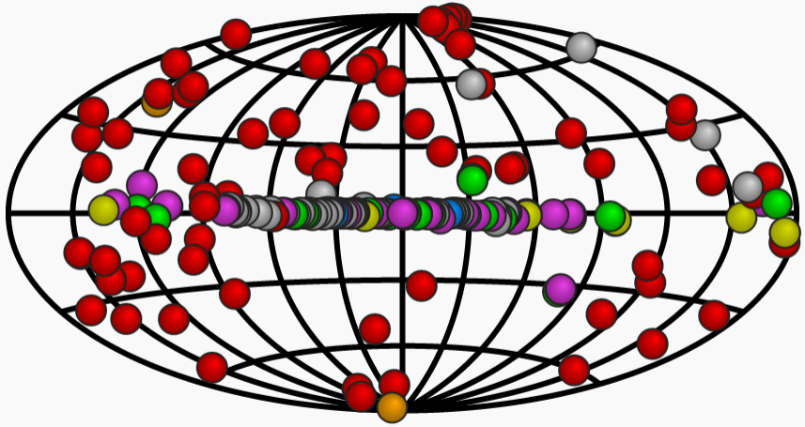
1. What is the population of TeV gamma-ray sources?
Nearly 200 sources from many different source classes and sub-categories.
Pulsar wind Nebula
Active Galactic Nucleus
Supernova Remnant
Starburst Galaxy
Unidentified
Binary system
Stellar Cluster
http://tevcat2.uchicago.edu/

Slide 14
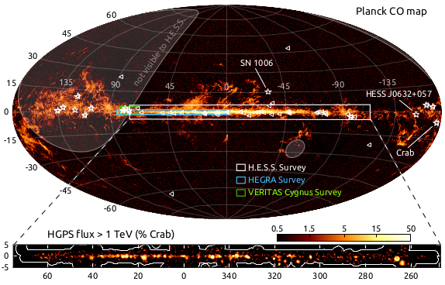
https://www.mpi-hd.mpg.de/hfm/HESS/pages/home/som/2016/01/
Notes:
An overview image showing the H.E.S.S. Galactic Plane Survey (HGPS) region (top), the measured TeV gamma-ray flux (middle), and the observation time (bottom). For reference, the all-sky image shows the distribution of gas in the sky, as revealed by recent carbon monoxide (CO) measurements by the Planck satellite (Adam et al. 2015). Overplotted (triangles) are Galactic gamma-ray sources measured at lower but complementary energies, recently detected by the Fermi-LAT satellite (Ackermann et al. 2015). The 15 Galactic TeV sources known to be outside the HGPS region are also indicated (stars). The regions covered by earlier, more limited surveys are also illustrated. The middle panel show the HGPS gamma-ray flux above 1 TeV (correlation radius of 0.4°), and the bottom panel shows the respective observation livetime. The white contours mark the edge of the survey region.
77 sources in the plane survey. 16 unidentified.

Slide 15
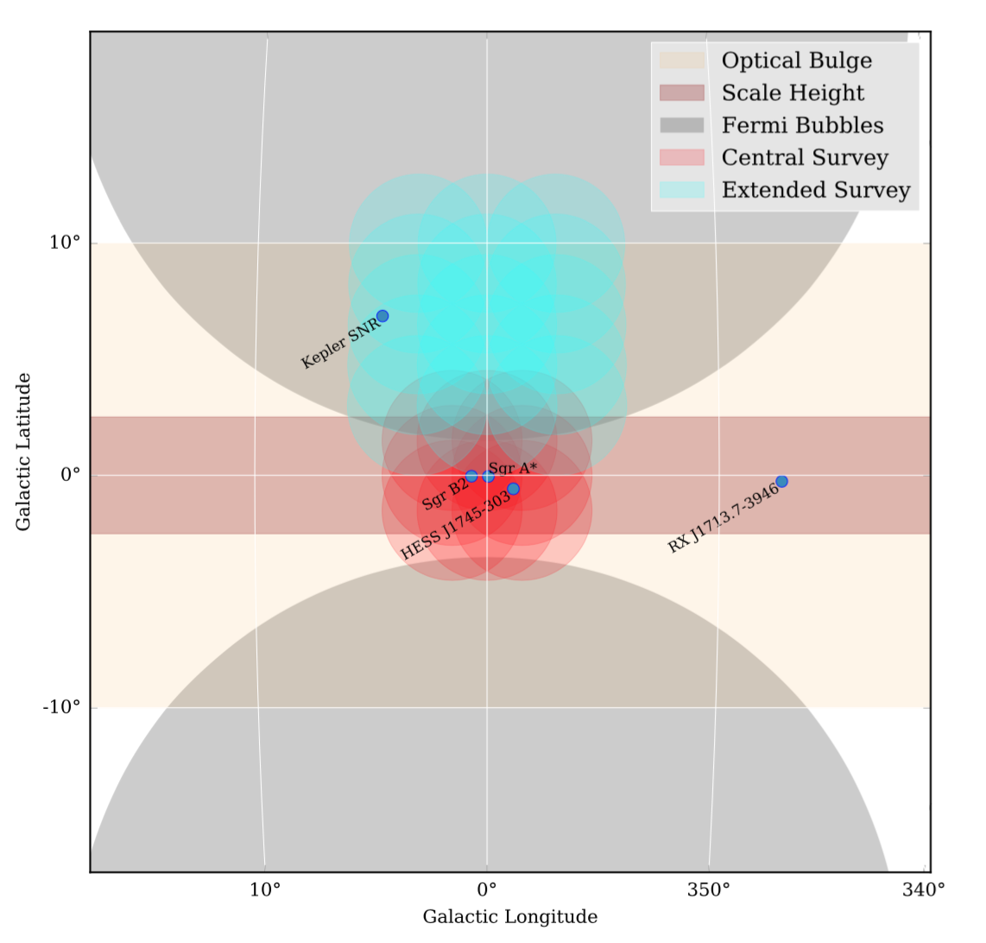
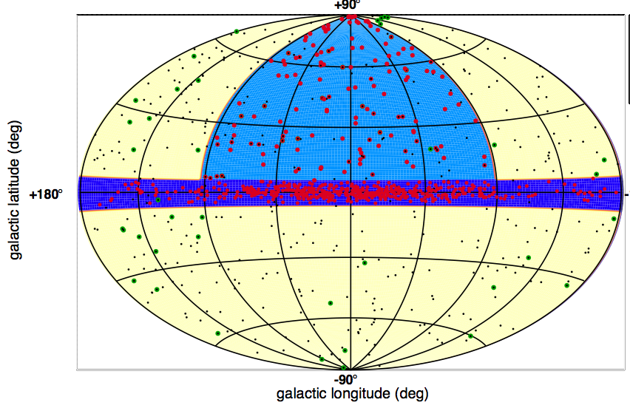
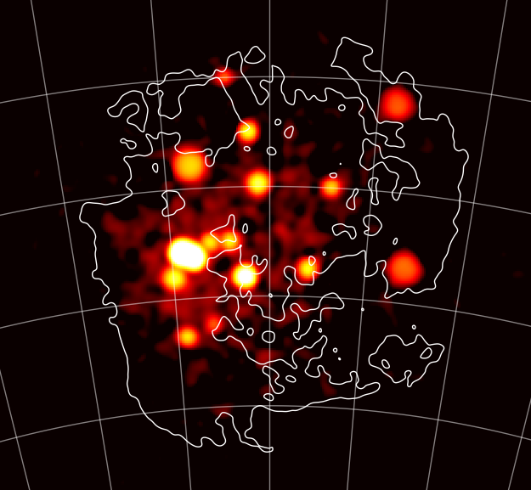
The Future:
Surveys with CTA
Galactic Center Survey
  Central region: 525 hr
  Extended region (to +10°): 300 hr
Extragalactic Survey
  Quarter of the sky to ~6mCrab
  1000 hr in total
Large Magellanic Cloud Survey
  340 hr
Galactic Plane Survey
  Entire plane to ~2 mCrab
  1620 hr in total
Notes:
Galactic Center: identify the central source. Measure it’s spectrum and morphology and variability. Study the diffuse emission (spectrum and morphology. Search for DM.
LMC: Face-on satellite galaxy with high SFR Extreme Gal. sources, diffuse emission (CRs) DM search;
Extragalactic: Unbiased survey of ¼ sky to ~6 mCrab VHE population study, duty cycle. New, unknown sources; 1000 h
Galactic Plane Survey: Survey of entire plane to ~2 mCrab. Galactic source population: SNRs, PWNe, etc.
PeVatron candidates, early view of GC, 1620 h

Slide 16
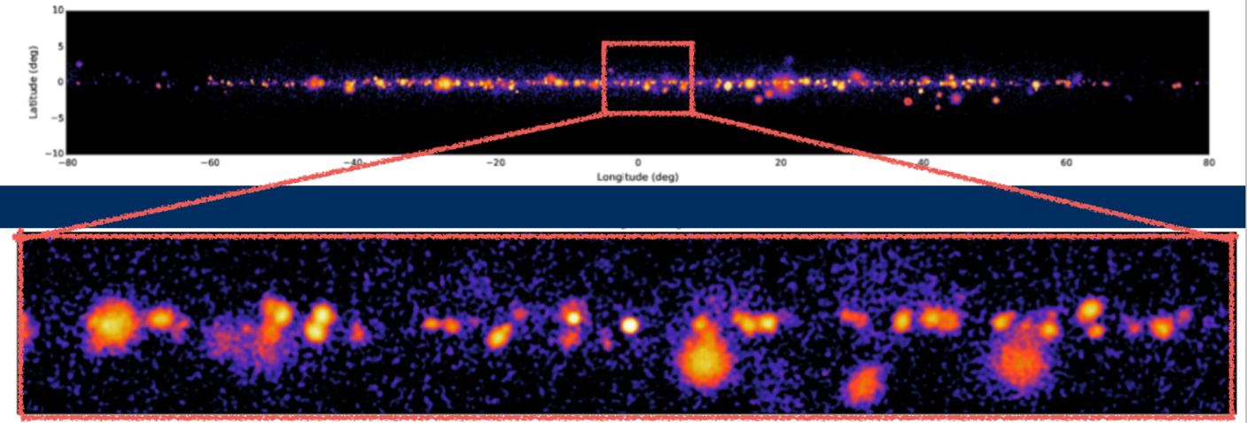
Galactic Plane Survey with CTA
Will detect many hundreds of sources.
Provides population studies of pulsar wind nebulae, supernova remnants.
Allows searches for new gamma-ray binaries and pulsars.
Allows searches for PeVatrons, new source classes and transients.
https://www.cta-observatory.org/ctas-galactic-plane-survey-will-provide-unprecedented-view-galaxy/
Notes:
1 – 3 mCrab
See: Astroparticle Physics, Vol. 43, 1-356 (2013) & CTA Contributions to the 2015 ICRC Conference [arXiv:1508.05894]

Slide 17
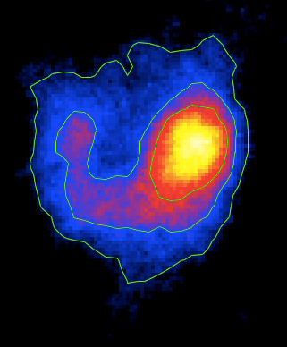
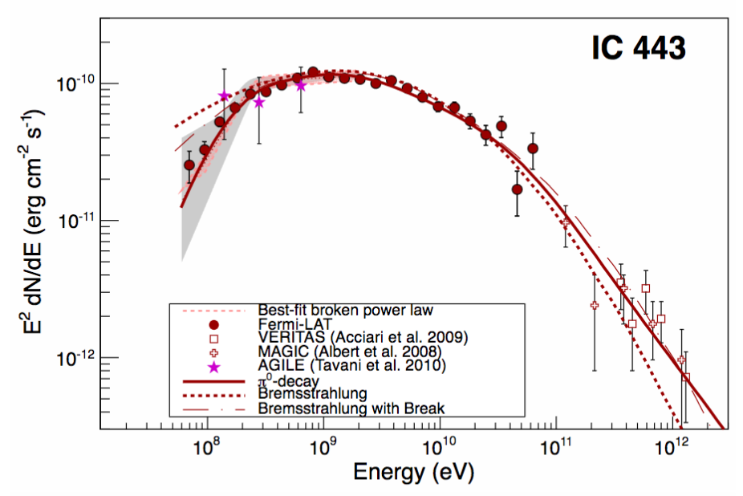
2. What is the origin of the cosmic rays?
Particle acceleration takes place in supernova remnants.
Gamma-ray emission identifies the acceleration sites.
Particle population is ambiguous: leptonic or hadronic emission may dominate.
Where hadronic emission is identified, the source spectra cut off at high energies.
IC 443 with VERITAS
Fermi-LAT Collaboration Science 339, 807, 2013
Notes:
RXJ has 2 component proton spectra cutting off at a few TeV

Slide 18
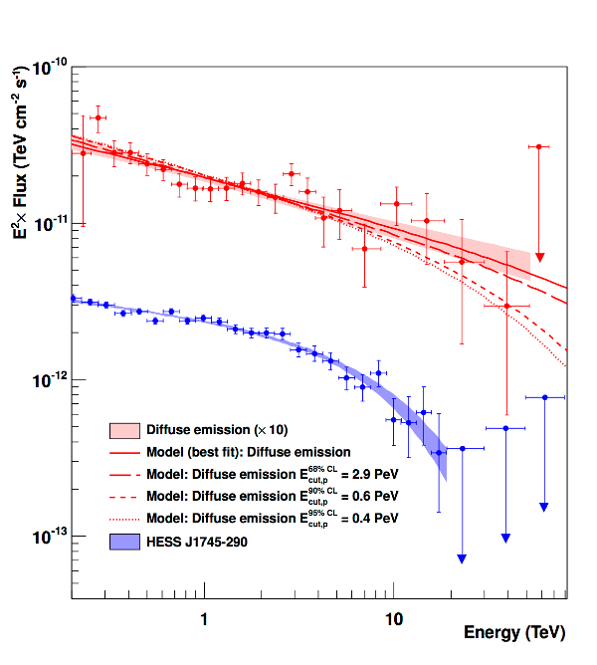
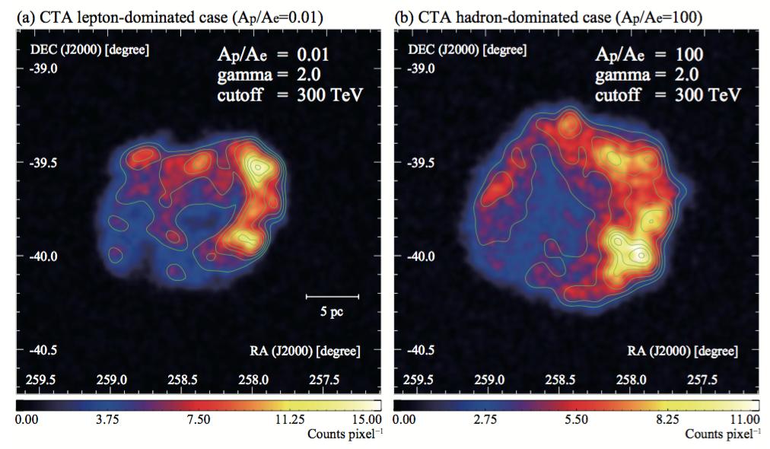
To produce the Galactic population of cosmic rays up to the knee requires PeVatrons.
There may be one at the Galactic Center (or there may have been).
CTA will search for others, by extending the energy range to hundreds of TeV.
Improved angular resolution will also help to discriminate between models.
Galactic Center with H.E.S.S.
RX J 1713 .7-3946 with CTA
H.E.S.S. Collaboration, Nature 531, 476-479 (2016)
CTA Collaboration, ApJ (arXiv:1704.04136)
Notes:
The detection of an SNR whose spectrum extends without any appreciable attenuation up to energies of ∼100 TeV would imply that: i) the emission is hadronic, because the leptonic emission is strongly suppressed at such high en- ergies due to Compton losses in the Klein-Nishina regime, and ii) the SNR is a PeVatron, because ∼100 TeV photons are produced by ∼PeV protons
https://www.mpi-hd.mpg.de/hfm/HESS/pages/home/som/2016/04/
The energy spectrum of the diffuse γ-ray emission measured by H.E.S.S. follows a power law extending with a photon index of ~2.3 to energies up to tens of TeV, without a cut-off or a break (see Figure 4). This is the first time that such a γ-ray spectrum, arising from proton-proton interactions, has been detected. Since these γ-rays result from the decay of neutral pions produced by these interactions, the derivation of such a hard power-law spectrum implies that the spectrum of the parent protons should extend to energies close to 1PeV. The best fit of γ-ray spectrum from neutral pion decay to the H.E.S.S. data is found for a proton spectrum following a pure power law with an index of ~2.4. Assuming a cut-off in the parent proton spectrum, the corresponding secondary γ-ray spectrum deviates from the H.E.S.S. data at 68%, 90% and 95% confidence levels for cut-offs at 2.9 PeV, 0.6 PeV and 0.4 PeV, respectively. This is the first robust detection of a Galactic cosmic Pevatron.
1 – 10 million years of acceleration by the black hole at

Slide 19
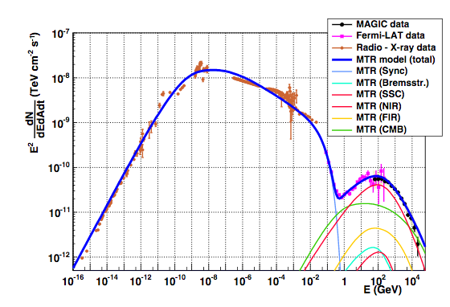
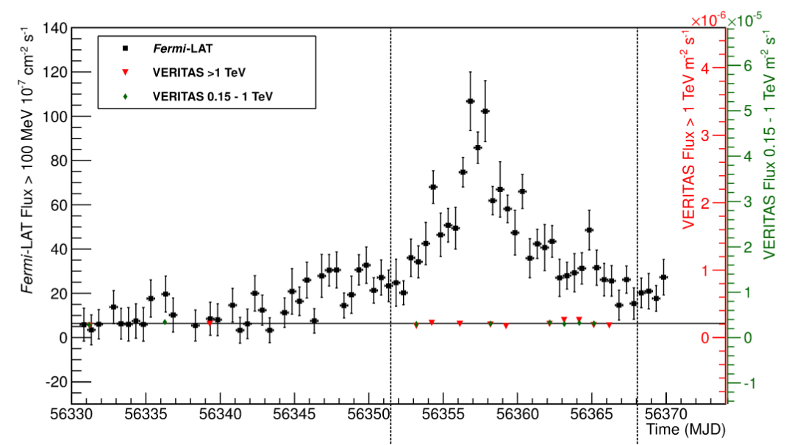
3. What is the nature of gamma-ray emission from the Crab?
The Crab Nebula was the first astrophysical TeV gamma-ray source proposed (by Cocconi, 1959), and the first to be firmly detected (by Whipple, in 1989) – although at 1/10,000 of the predicted flux!
Emission is SSC of leptons accelerated near the termination shock of the pulsar wind.
The Fermi-LAT measured Crab flares have no counterpart at TeV.
MAGIC Collaboration, JHEAp, 5, 30, 2015.
VERITAS Collaboration, ApJL, 781, 11, 2014.
Notes:
These relativistic particles are thought to be ac
celerated to a power-law distribution either via a Fermi-like a
cceleration process taking place at the termination shock (T
S) (Arons & Tavani 1994, and references therein) or via shock-
driven reconnection in a striped wind (P ́etri & Lyubarsky 20
07; Sironi & Spitkovsky 2011). The downstream flow interacts with
the surrounding magnetic and photon fields creating the PWN.
The nebula emits synchrotron radiation which is observed from
radio frequencies up to soft γ rays. This emission is well de-
scribed by the magnetohydrodynamic (MHD) model of Kennel & C
Oroniti (1984). At higher energies (above 1 GeV), the overall emission
is instead dominated by the Inverse Compton (IC) up-scattering
of synchrotron photons by the relativistic electrons in the neb-
ula (de Jager & Harding 1992; Atoyan & Aharonian 1996)
According to magnetohydrodynamic (MHD) models, the rotational energy of a rapidly spinning neutron star is carried away by a relativistic wind and deposited at a large distance, in the nebula, downstream of the wind termination shock. The energy transport in the outflow is mediated by Poynting flux, but it is not clear how the energy stored in the fields is transferred into the energized population of emitting particles. The most plausible dissipation mechanisms are thought to be related to the "striped" structure of the wind, in particular, to the existence of a current sheet, prone to reconnection events. In this model the current sheet is a natural place for internal dissipation and acceleration of particles responsible for pulsed, high-energy emission. Moreover, reconnection is a promising scenario for explaining annihilation of fields at the shock and conversion of their energy into the kinetic energy of particles. The shock structure, however, is likely to differ in the low-density plasmas, in which non-MHD effects intervene. In this regime, the striped wind can dissipate its energy via an electromagnetic precursor of the shock.

Slide 20
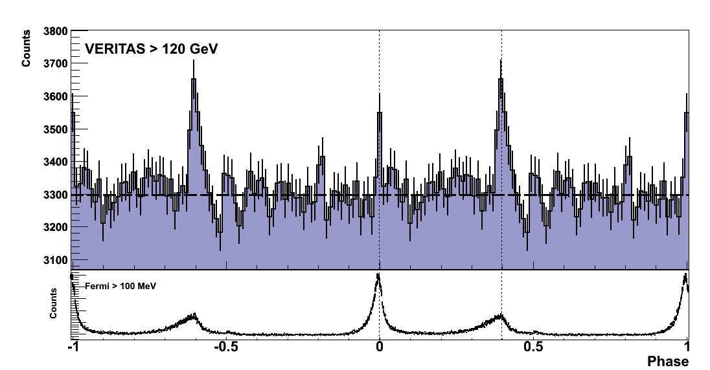
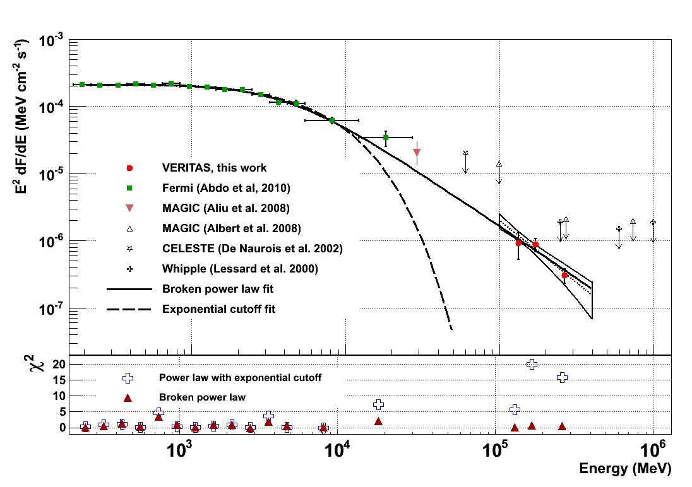
The Crab Pulsar
Fermi-LAT measures a spectral break at 6 GeV
VERITAS measures unpredicted emission above 100 GeV
Implies emission region > 10 stellar radii.
Absence of exponential cutoff makes curvature radiation unlikely as the dominant mechanism at these energies.
Latest MAGIC results extend to 1 TeV.
CTA will measure at least 12 Fermi pulsars, and tell us if the Crab is the only TeV pulsar.
The Crab pulsar lightcurve >120 GeV
The Crab pulsar spectrum
VERITAS Collaboration, Science, 334, 69, 2011.
Notes:
(Spin-down E= 4.6 x 10³⁸ erg s⁻¹.)

Slide 21
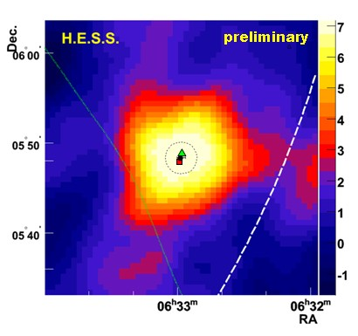
4. Is Cyg X-3 a TeV gamma-ray source?
Are binary systems in general TeV sources?
Cygnus X-3 motivated the birth of the field in the 70’s and 80’s.
The early results were likely spurious. Cyg X-3 is a Fermi-LAT source, but the emission does not extend in to the >100 GeV range.
A small population of TeV binaries have been detected.
CTA will add to this – but probably not more than a handful.
HESS J0632+057
HESS J0632+057
Notes:
Gamma-ray binaries are probably a short-lived phase in the evolution of massive star binaries, following the birth of the neu- tron star and preceding the HMXB phase, when the neutron star accretes material captured from the stellar wind instead of hold- ing it back (see Tauris & van den Heuvel 2006 for a review on the formation of compact objects in binaries). Accretion occurs if the ram pressure from accreting matter is able to overcome the pulsar wind, turning off the pulsar mechanism (Shvartsman 1971; Illarionov & Sunyaev 1975; Lipunov et al. 1994; Cam-
Article number, page 1 of 12
pana et al. 1995). A gamma-ray binary can thus transition to a HMXB on the typical spindown timescale of young pulsars, a few 105 years. The evolution of the companion eventually leads to a second supernova with the formation of another compact ob- ject. Therefore, besides the unique opportunities they provide to understand the physics of pulsar winds, gamma-ray binaries also offer a window into the pulsar and orbital parameters of systems that remain bound after a supernova, and constrain the formation paths to double neutron stars and coalescing compact objects.

Slide 22
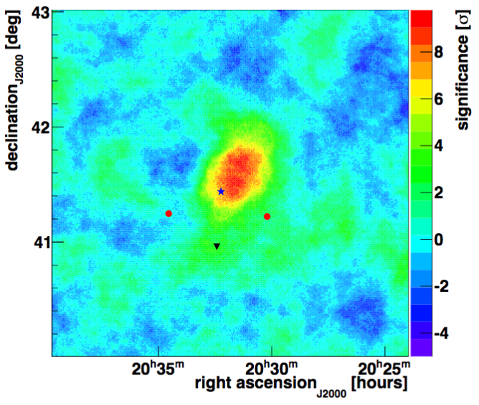
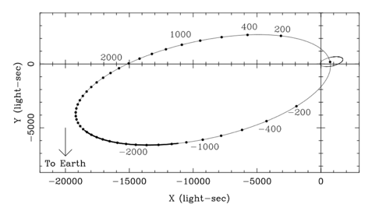
4. Is Cyg X-3 a TeV gamma-ray source?
Are binary systems in general TeV sources?
Cygnus X-3 motivated the birth of the field in the 70’s and 80’s.
The early results were likely spurious. Cyg X-3 is a Fermi-LAT source, but the emission does not extend in to the >100 GeV range.
A small population of TeV binaries have been detected.
CTA will add to this – but probably not more than a handful.
Another one coming soon ?
PSR J2032+4127
40-45 year orbit!
Periastron
November 2017
TeV J2032+4130
PSR J2032+4127
Cygnus X-3
22

Slide 23
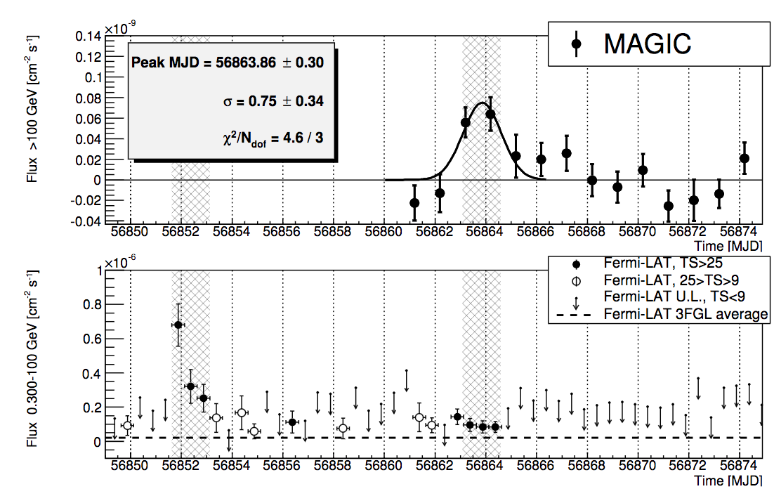
5. How far can we see?
Above 10 GeV, gamma-ray photons are absorbed by pair production with photons of the extragalactic background light.
  This limits the gamma-ray observable Universe.
  But allows to measure or constrain the EBL.
Active Galactic Nuclei with redshifts of ~1 have been detected by the current generation.
QSO B0218+357
z=0.944

Slide 24
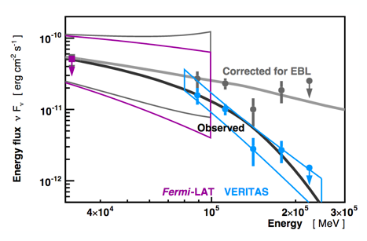
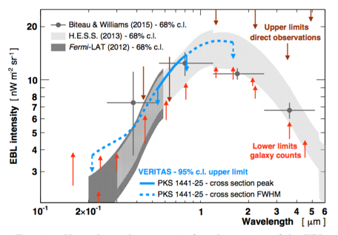
5. How far can we see?
Above 10 GeV, gamma-ray photons are absorbed by pair production with photons of the extragalactic background light.
  This limits the gamma-ray observable Universe.
  But allows to measure or constrain the EBL.
Active Galactic Nuclei with redshifts of ~1 have been detected by the current generation.
PKS 1441+25
z=0.939

Slide 25
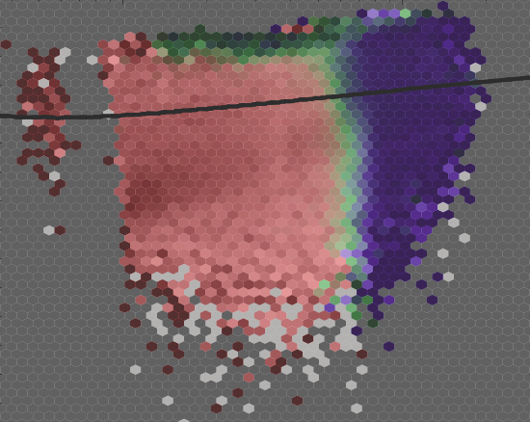
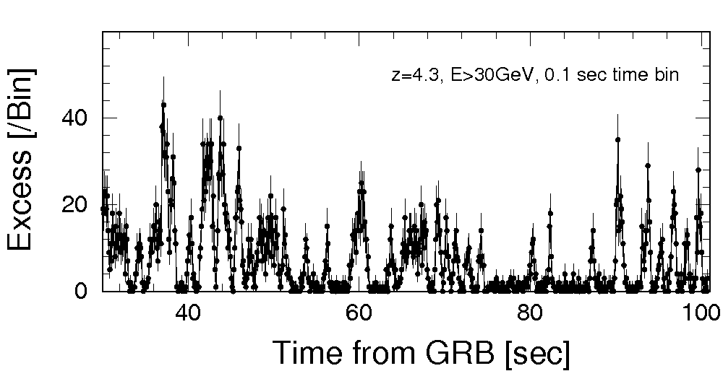
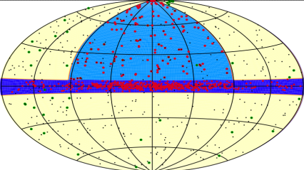
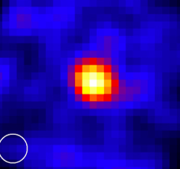
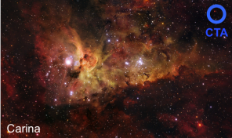
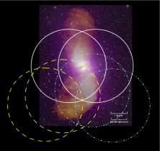
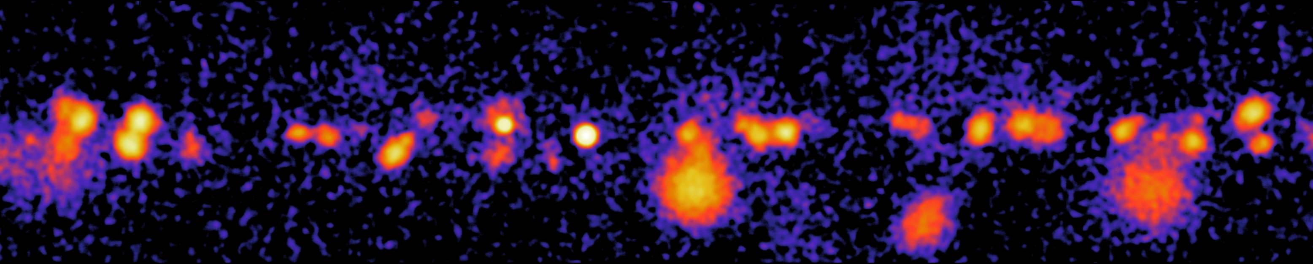

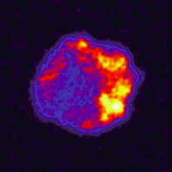

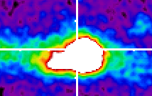
Addressing new questions: CTA Key Science Projects
Transients
Dark Matter
Programme
ExGal
Survey
Galaxy
Clusters
Star Forming Systems
Galactic Extragalactic
AGN
LMC
Survey
Galactic
Plane Survey
PeVatrons
Galactic
Centre
25

Slide 26
Time Allocation & Community Access
Community*
All CTA data will be fully open
after a proprietary period
CTA Consortium
Key Science Projects
*of scientists from nations contributing to CTA construction and operations and from site host nations
Notes:
26
26

Slide 27
Summary
  “Your talk should be presented as a compact presentation of
  recent results and major open questions persisting in the field, with an emphasis on what can be done in the coming decade -experimentally, theoretically or both - to resolve these questions.”
TeV gamma-ray astronomy is rich with results, but is far from reaching its full potential.
Great progress has been made on many of the original questions.
The answers lead to new (and interesting) questions!
See Brian Humensky’s talk at this meeting for prospects for gamma-ray searches for astrophysical neutrino counterparts.
Notes:
z>0.6035

Slide 28
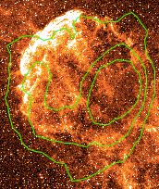
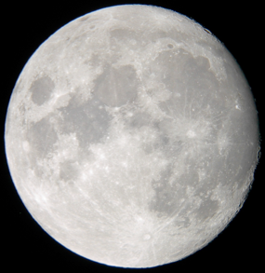
IC 443 with VERITAS
Notes:
Molecular line observations indicate SNR shock interacting with
~1.1x104 M along southern ridge (e.g. Lee+ 2008)
A deep observation of IC 443 with VERITAS has resolved VHE emission from the entire remnant
Analysis is ongoing – but this is a very powerful laboratory.
In combination with Fermi-LAT, we can correlate the physical conditions with gamma-ray emission and study the environmental dependence of cosmic-ray diffusion.

Slide 29


SITES

Slide 30



New Questions: CTA Science Themes
Cosmic Particle Acceleration
  How and where are particles accelerated?
  How do they propagate?
  What is their impact on the environment?
Probing Extreme Environments
  Processes close to neutron stars and black holes
  Processes in relativistic jets, winds and explosions
  Exploring cosmic voids
Physics frontiers – beyond the Standard Model
  What is the nature of Dark Matter? How is it distributed?
  Is the speed of light a constant for high-energy photons?
  Do axion-like particles exist?
See: Astroparticle Physics, Vol. 43, 1-356 (2013) & CTA Contributions to the 2015 ICRC Conference [arXiv:1508.05894]

Slide 31









Broad Spectrum of Science
Particle Acceleration
Dark Matter
Cosmology
Cosmic Rays
Space Time
Annihilation
Supernova Remnants
Extragalactic Background Light
Pulsars
Active Galactic Nuclei
Primordial Black Holes
Axion-like Particles
Gamma-ray Bursts
... ?
Opens discovery space by major improvements in sensitivity, FoV,
energy range

Slide 32



Particle Astrophysics and Fundamental Physics
Using distant blazars as cosmological probes
Hunting for dark matter in dwarf spheroidals and galaxy clusters
Cosmic ray measurements
Coma cluster
Notes:
z>0.6035

