Slide 1
Heliosphere in the Local Interstellar Medium
Cosmic Ray Anisotropy Workshop
Chicago, IL, May 16-20, 2023
N.V. Pogorelov,^{1,2} R. Bera,² F. Fraternale,²
and M. Zhang³
¹Department of Space Science, University of Alabama in Huntsville
²Center for Space Plasma and Aeronomic Research, University of Alabama in Huntsville
³Florida Institute of Technology, Melbourne, FL

Slide 2
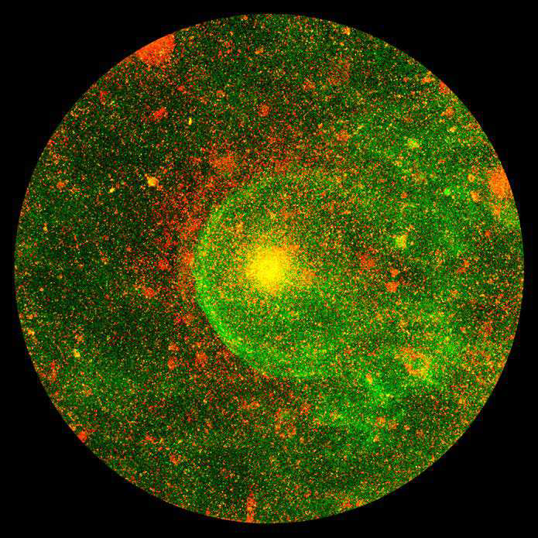
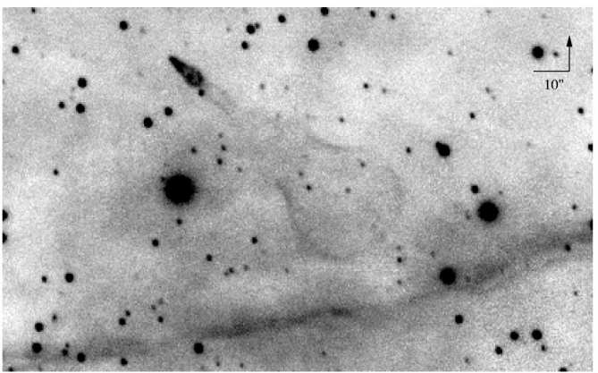
(Left panel.) The Guitar nebula (from Chatterjee & Cordes, 2002).
(Right panel.) Carbon Star IRC+10216 (from Sahai & Chronopoulos, 2010).
Clearly the interaction pattern is substantially different!
How about the heliosphere interaction with the LISM?

Slide 3
Two scenarios from Parker (1961)

Slide 4
A two-shock model (Baranov et al., 1974)
Solar wind:
V_{p} = 450 km/s, n_{p} = 7.4 cm⁻³, and T_{p} = 51100 K.
LISM:
V∞ = 26.4 km/s, n∞=0.05 – 0.07 cm⁻³,
T∞ = 6500 K, n_{H∞} = 0.15 – 0.18 cm⁻³.
Neutral particles play a major role in the SW-LISM interaction (Wallis 1971, 1975; Baranov & Malama 1993; Zank et al., 1996; Fahr et al. 2000; Florinski et al. 2003-; Izmodenov et al., 2005-; Heerikhuisen et al., 2006-, Pogorelov et al. 2006-).
1
1
3
2
The solar wind (SW) termination shock weakens due to the SW deceleration and heating; interstellar hydrogen atoms are filtered at the heliopause due to their intensified charge exchange with decelerated ions; the LISM velocity and temperature change due to the LISM charge exchange with the hot secondary
H atoms originating in the compressed solar wind behind the termination shock.

Slide 5
The LISM is partially ionized and charge exchange events are infrequent, hence two types of the SW-LISM interaction models.
Multiple neutral atom fluids (especially useful for time-dependent modeling).
Neutral atoms are treated kinetically, i.e., described more accurately.
Charge exchange not only changes the size of the heliosphere, but also its geometry, making it more symmetric with respect to the LISM velocity direction. The asymmetry exists with respect to the BV-plane though.

Slide 6
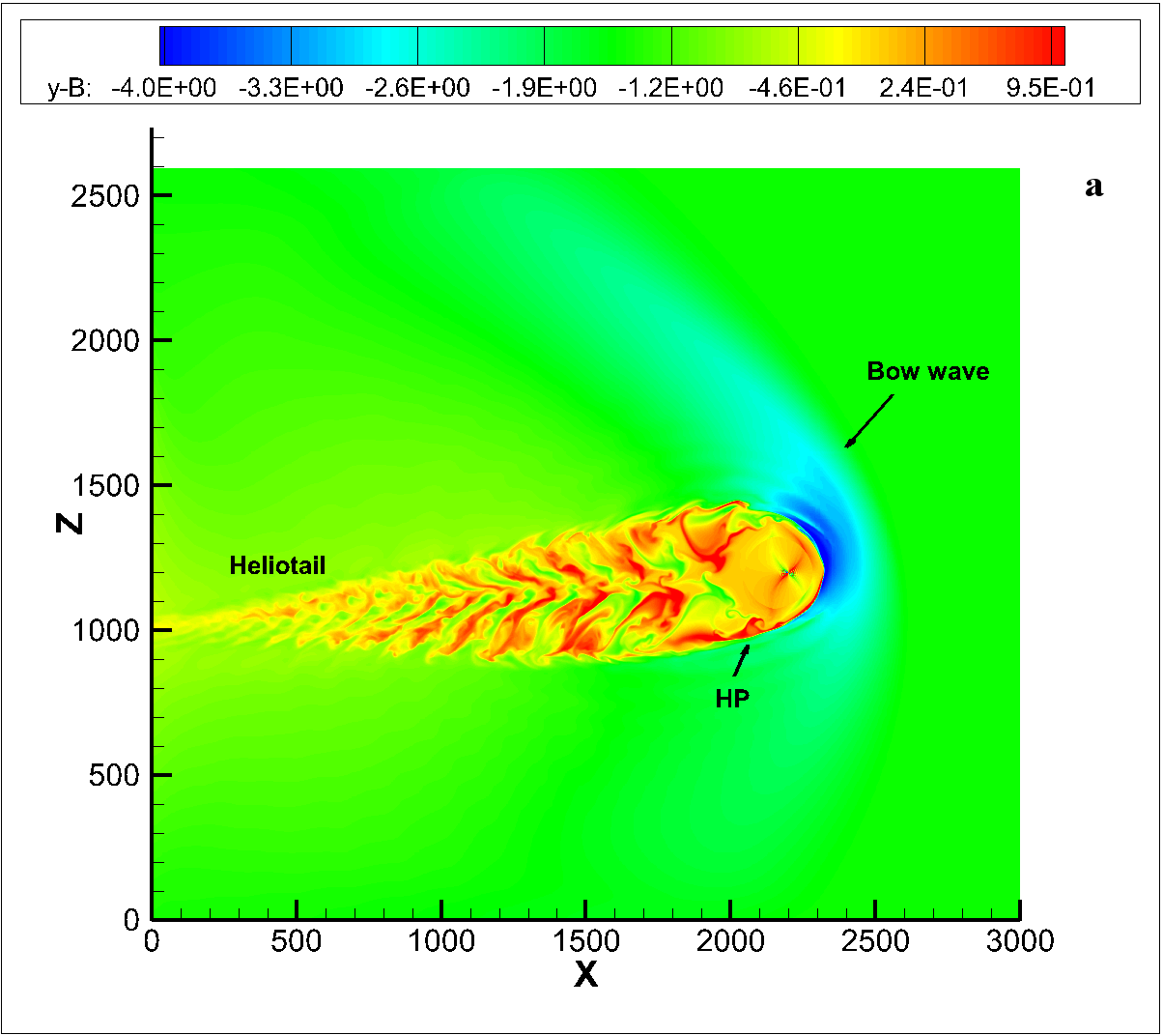
A general picture of the SW-LISM interaction. The out-of-plane component of B is shown. The patches in the tail are due to the solar cycle.
Left panel: The IBEX ribbon: a sketch from McComas et al. (2010).

Slide 7
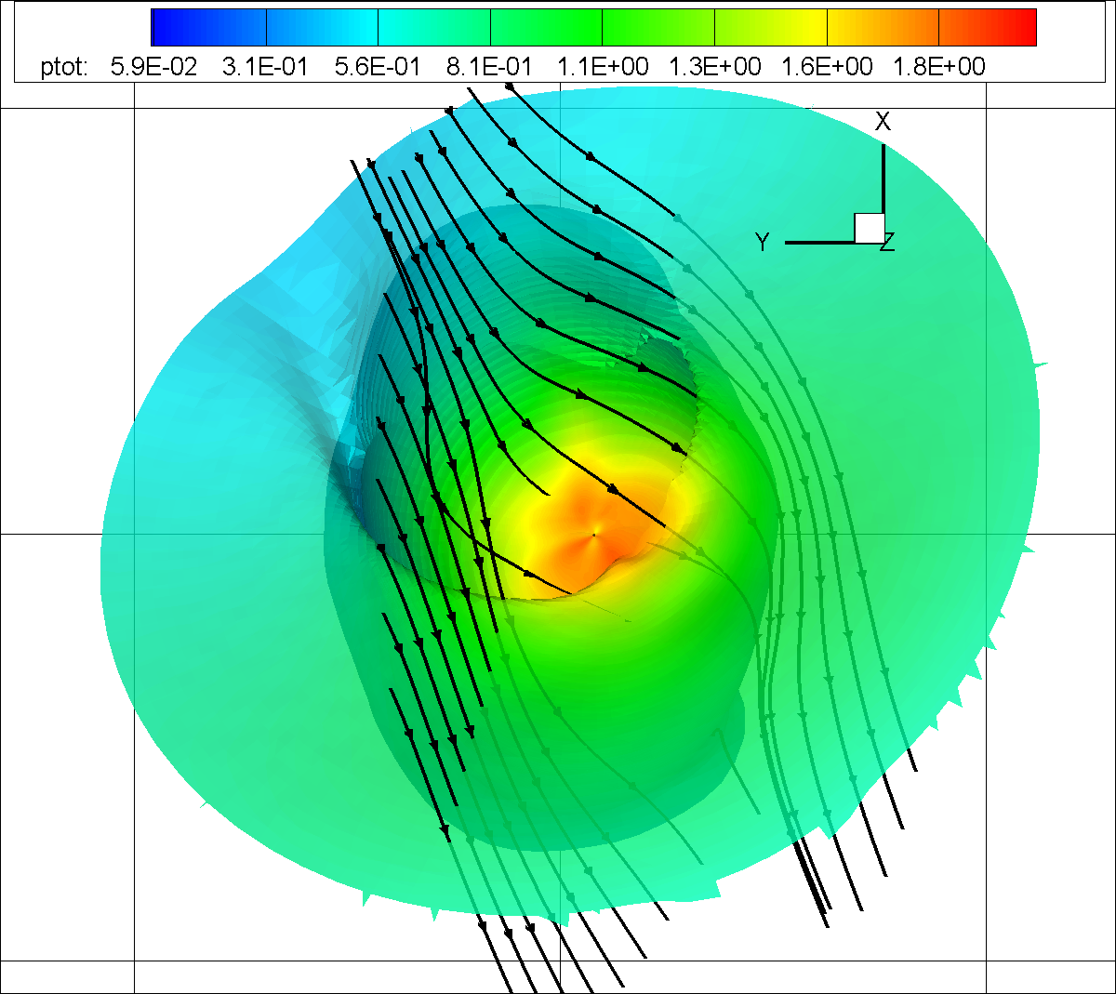
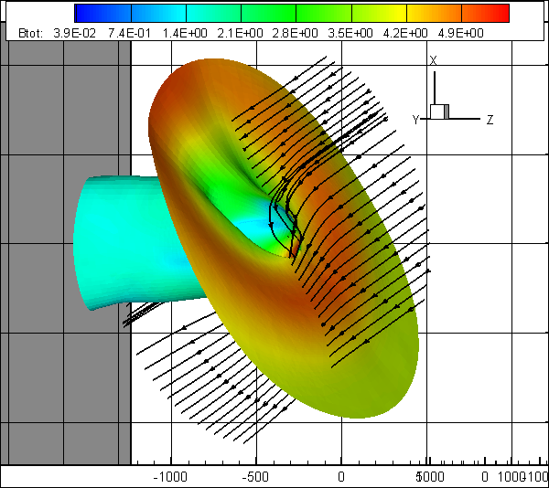
ISMF Direction at the Heliopause Surface
The heliopause colored by the total pressure, ISMF lines draping the HP, and the surface B·R=0 in the MHD-kinetic simulation from Pogorelov et al. (2009). The ISMF is from λ ≈ 236º and b ≈ 30º. The direction λ=224° and b=41° fits the IBEX observations better. In both cases, the BV-plane is parallel to the HDP.
7

Slide 8
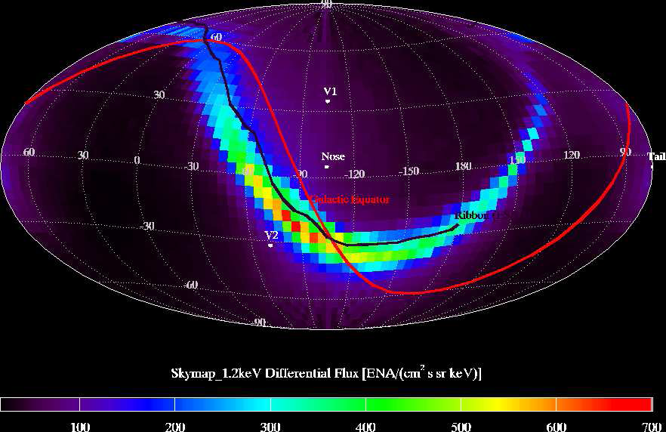
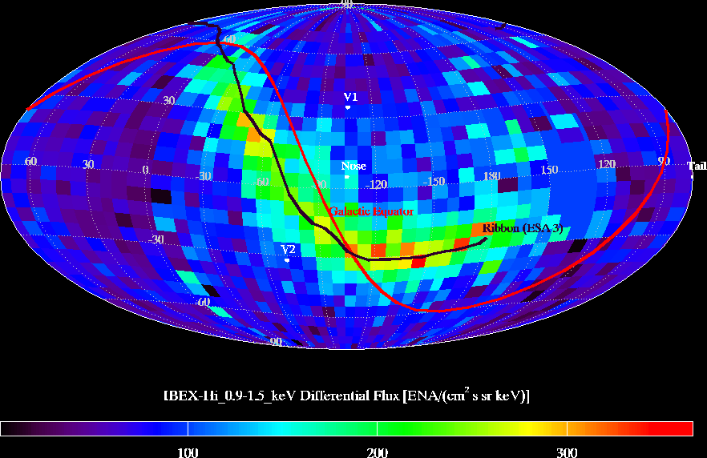
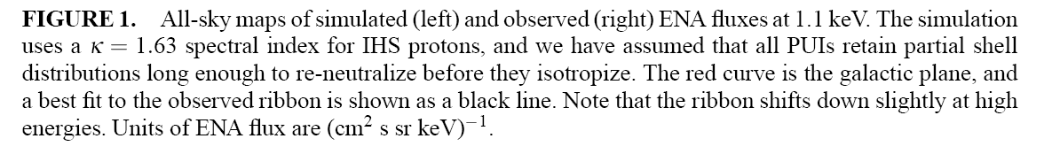
Deriving the IBEX Ribbon from Numerical Simulations
From Heerikhuisen et al. (2010)

Slide 9
Requirements to the Model Development
Interaction of the local interstellar medium (LISM) with the heliosphere involves MHD discontinuities on multiple scales: Efficient shock-capturing methods should be implemented in an adaptive mesh refinement (AMR) framework.
LISM is partially ionized: Charge exchange (collisions) between neutral atoms and ions should be taken into account, e.g., through a multi-fluid, multi-component approach.
3. Charge exchange events are very infrequent: MHD equations should be coupled with the kinetic Boltzmann equation.
Charge exchange of LISM atoms with solar wind (SW) ions creates non-thermal ions (pickup ions, PUIs): PUIs should be treated separately, e.g., by solving the Fokker-Planck equation, but simpler models are also used.
The PUI distribution function is unstable: Generation of turbulence and its interaction with ions should be addressed properly.
SW is time-dependent on different time scales: Spacecraft data and remote measurements should be used to create the boundary conditions.
Galactic cosmic ray transport can be simulated using the background plasma. Efficient data extraction is necessary.
8. Disparate spatial scales should be resolved for meaningful comparisons with observational data, which results in large data sets: Efficient I/O procedures should be developed and scalable parallelization implemented.

Slide 10
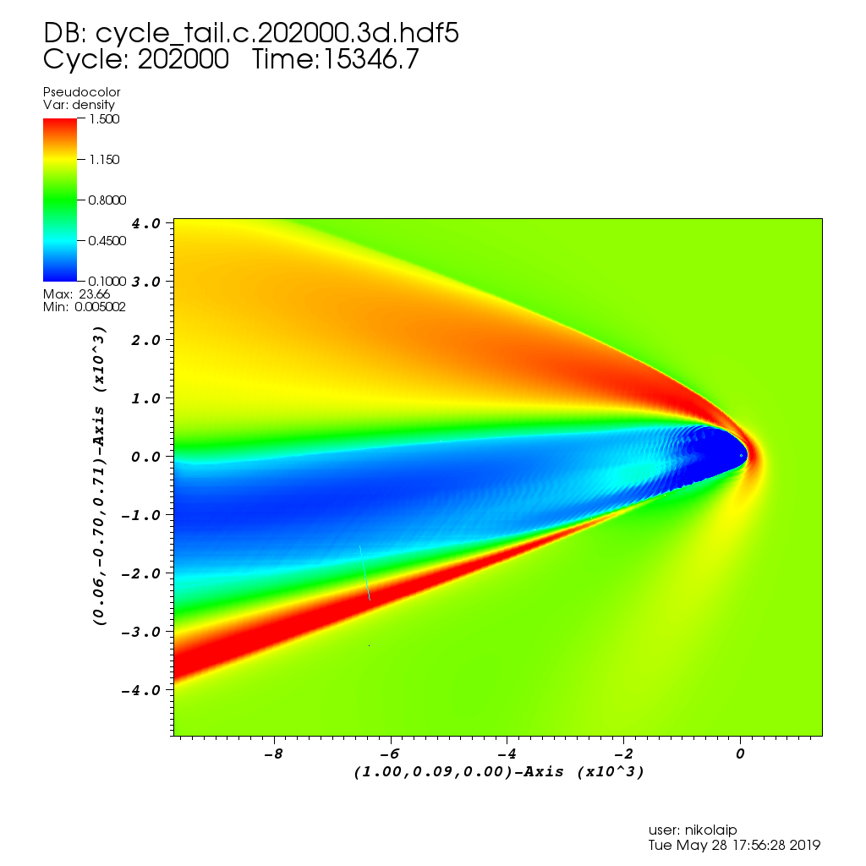
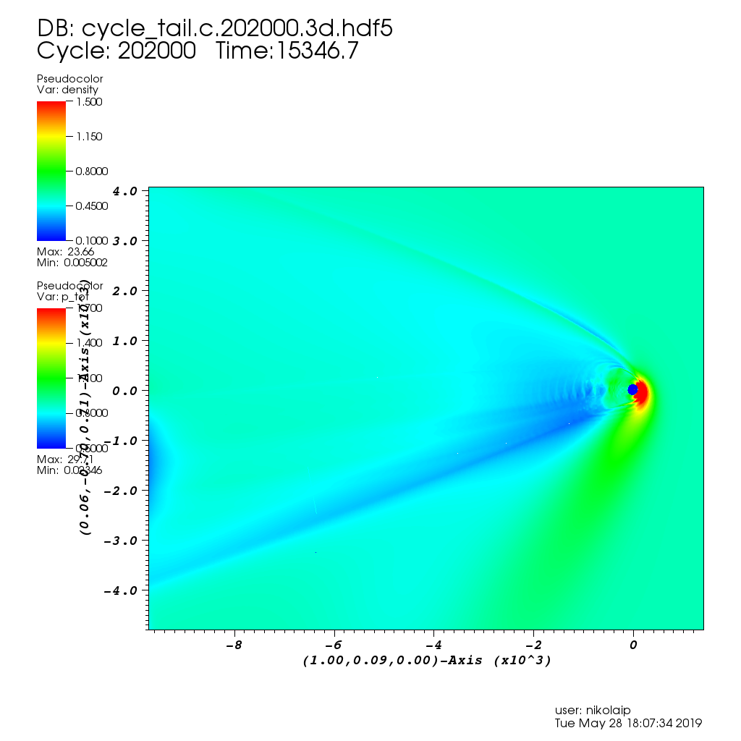
Plasma density and total pressure in the B-V plane.

Slide 11
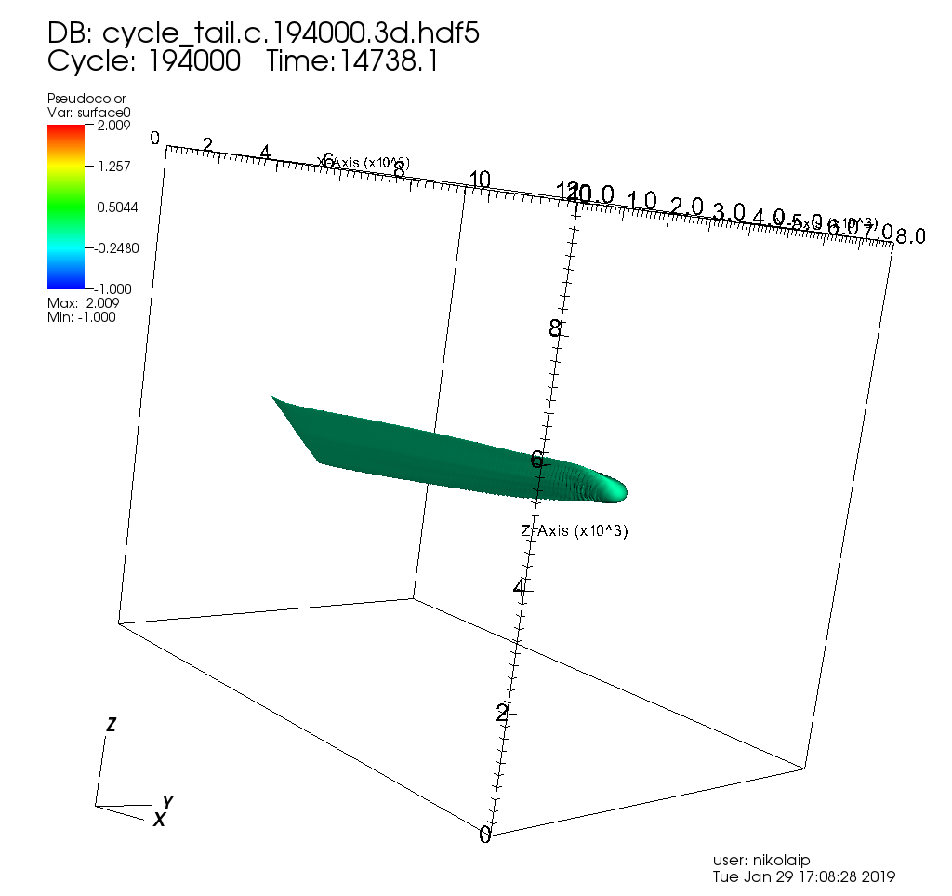
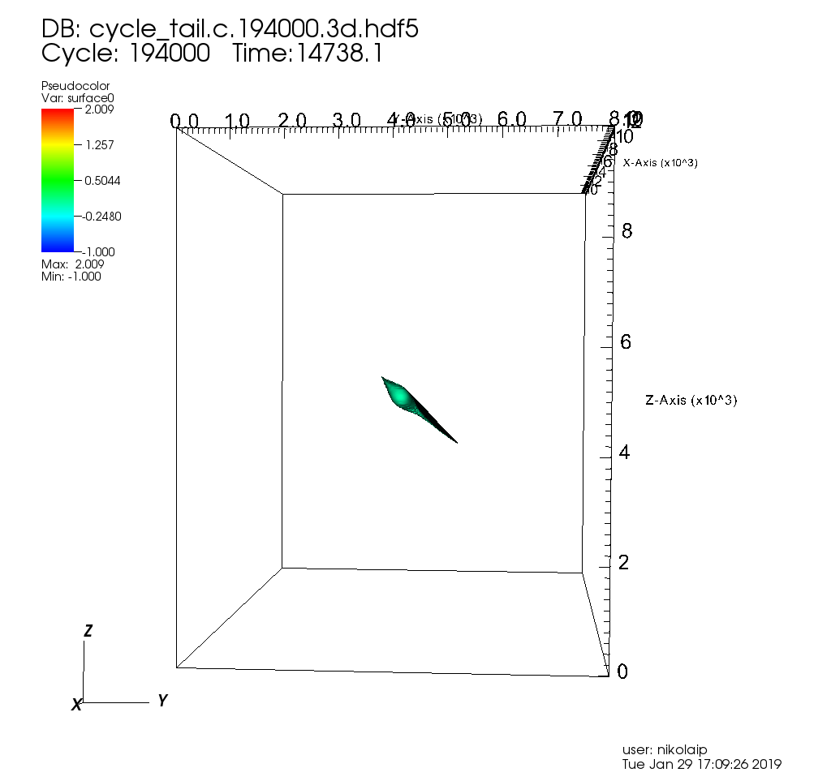
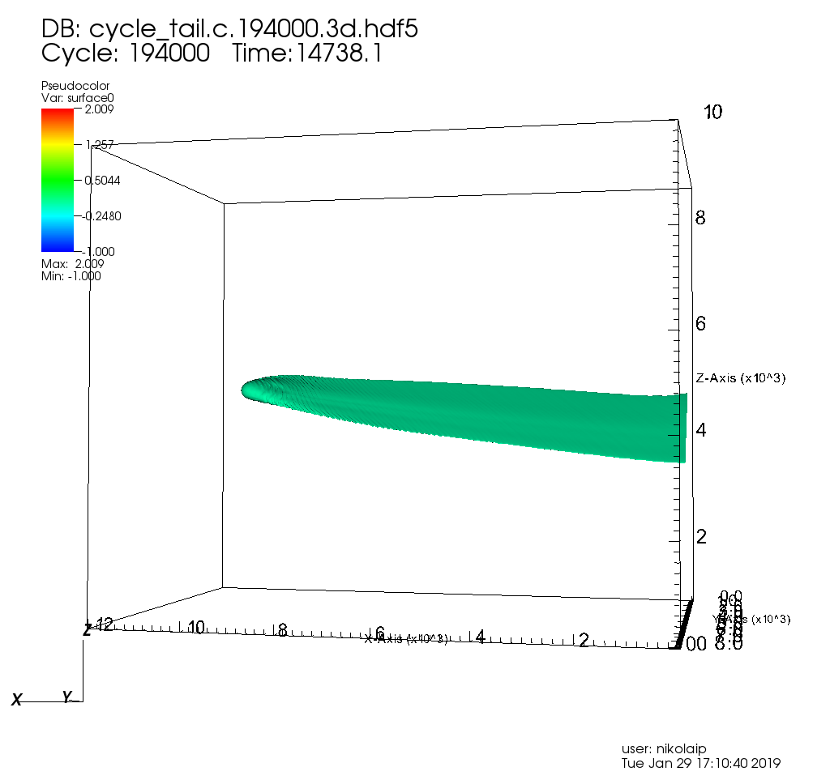
The heliopause seen from different perspectives.

Slide 12
TeV Cosmic Rays Anisotropy: Longer Tail is Better
10000 AU Tail
4400 AU Tail
4 TeV GCR fluxes
Tibet ASγ measurements

Slide 13
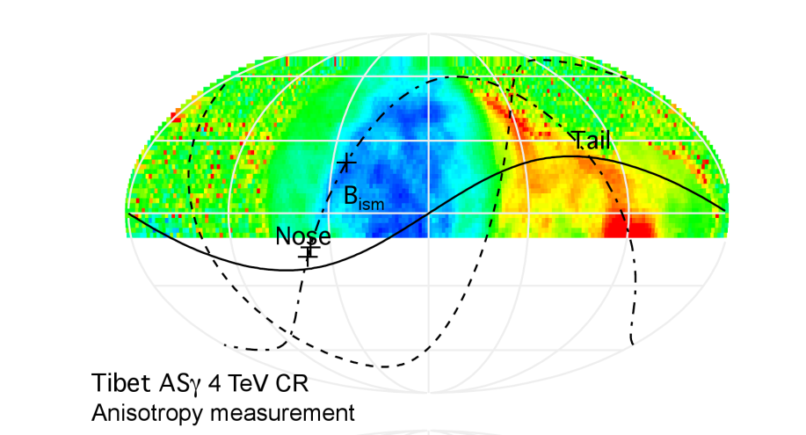
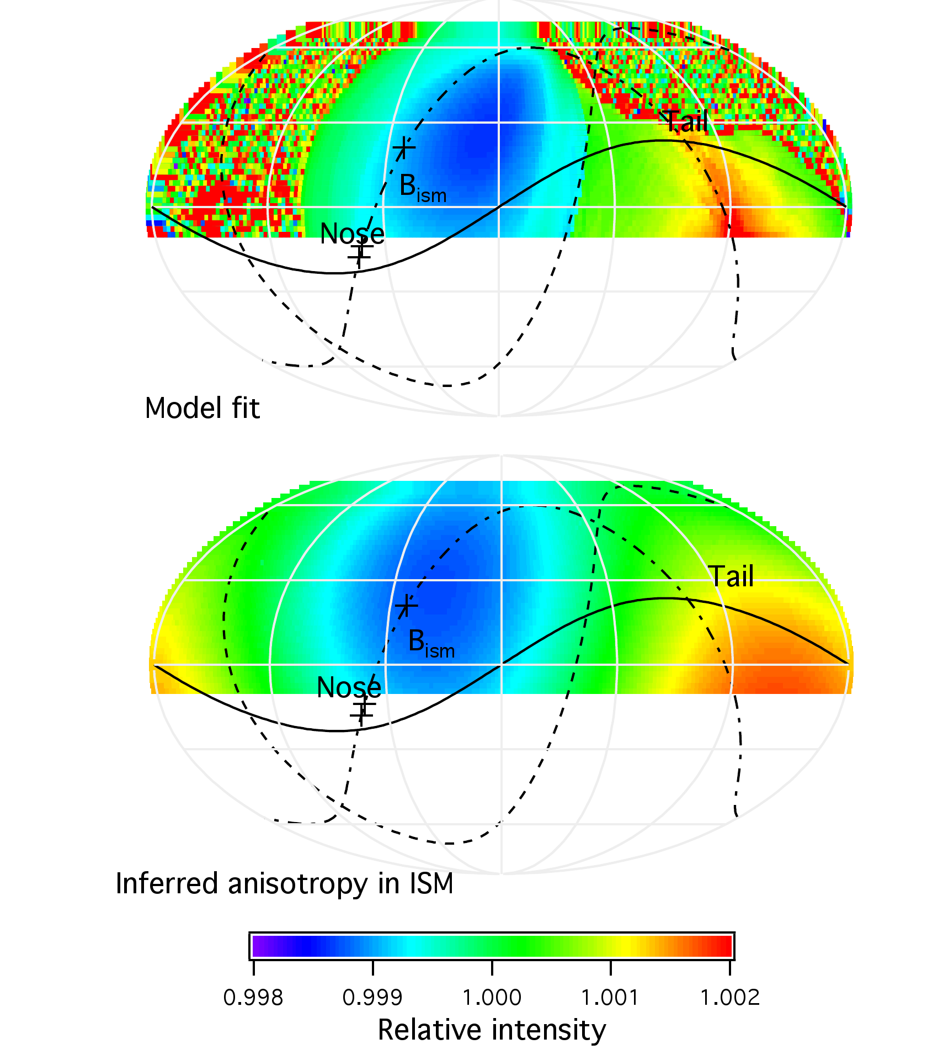
The Zhang et al (2019) results on the TeV GCR anisotropy
The heliosphere clearly affects the flux of 1-10 TeV cosmic rays. It appears that the heliotail and the B-V plane are prominently seen on the all-sky maps.

Slide 14
Heliospheric current sheet / sectors in the heliosheath
2 different approaches are pursued:
keep the dipolar field as is and let it dissipate due to turbulence near the heliopause;
assume a unipolar field and assign the signs afterwards.
Unipolar HMF simulation of Borovikov et al. (2011).
Similar approaches were used by Czechowski et al., Izmodenov et al., and Florinski et al.

Slide 15
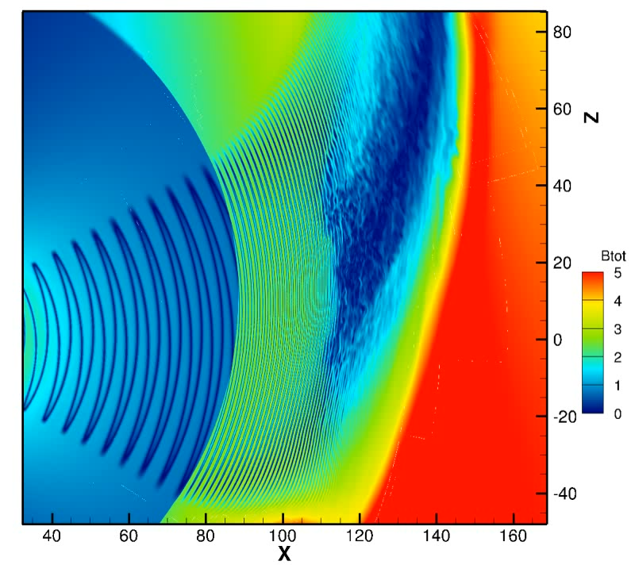
Transition to chaotic behavior in the IHS (Pogorelov et al., 2013)
A side note:
Traditional sectors do not exist beyond 10 AU or less.
No standard B-V exhausts have been observed by Voyagers. Involving turbulence may be a fruitful approach, since it produces the multifractal structure that is observed in the magnetic field strength.
An appropriate turbulence model s required!
Evolution of the heliospheric magnetic field in the inner heliosheath: the reason is tearing-mode instability due to numerical dissipation. In reality, such turbulent behavior is seen everywhere in the IHS.

Slide 16
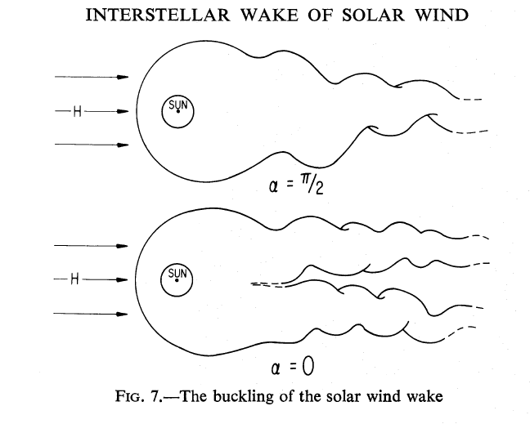
Maybe, it’s a two-tail creature after all?
From Yu (1974), see also Opher et al. (2015) and follow-ups.

Slide 17

Solutions in agreement with Yu (1974): almost split heliotail, plasma collimation, kink instability. Notice an artificial decrease in beta in the heliosheath.
All these features disappear for at least slightly more realistic HMF, e.g., a flat HCS.
Paraphrasing Dick Tracy, the one who controls magnetism, controls the Universe.
Unipolar IMF from Pogorelov + (2015). Direct comparison with Opher et al. (2015).

Slide 18
Assumption of the unipolar magnetic field is not accurate and exaggerates its effect in the inner heliosheath

Slide 19
Arguments against it:
It requires the HMF strength exceeding the measured values 5-7 times (Pogorelov et al., 2017b). This achieved in the model by assuming a unipolar character of the HMF and the absence of the heliospheric current sheet.
SW collimation of the type proposed by Yu (1974) is not possible in the presence of solar cycle effect, such as the variation of the latitudinal extent of the slow SW, which has density considerably higher than in the fast SW (Pogorelov et al., 2017a).
The croissant-like heliosphere disagrees with the observed anisotropy of 4 TeV galactic cosmic rays (Zhang & Pogorelov, 2016).
Even if the unrealistic assumption of unipolar HMF is taken for granted, Pogorelov et al. (2015) and Izmodenov (2018) showed that the SW collimation does not result in the heliotail splitting.
ENA ﬂuxes from the heliotail measured by IBEX are reproduced by Zirnstein et al. (2017) with the standard model of the heliospeher.

Slide 20
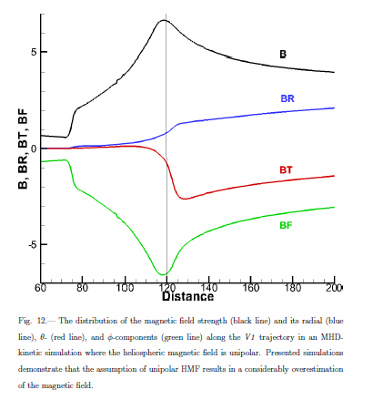
Paraphrasing Dick Tracy, the one who controls magnetism, controls the Universe.
The assumption of unipolar magnetic field – which is wrong – results in the increase of IHS magnetic pressure up to 50 times.
The result of that is well-known.

Slide 21
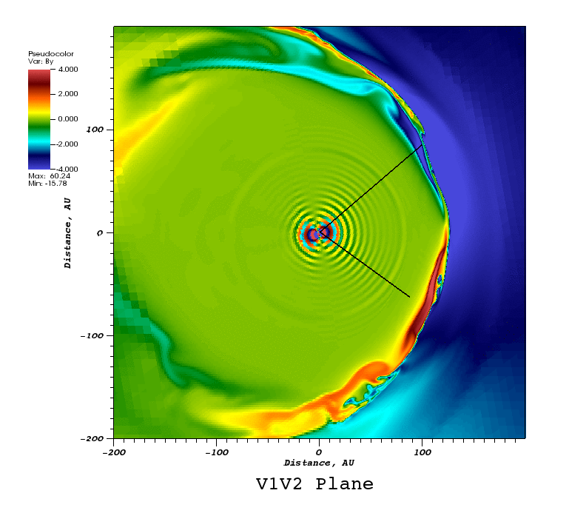
Instability of the heliopause and magnetic reconnection in its vicinity
Transverse component of B in the V1-V2 plane.

Slide 22
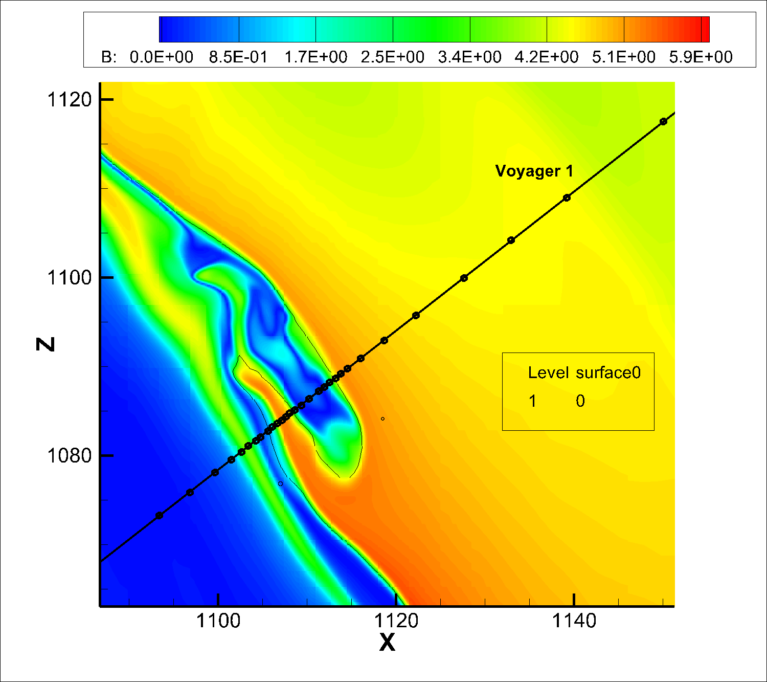
The heliopause – the boundary between the heliosphere and LISM – is unstable to KH and RT instabilities. Occasional magnetic reconnection is also possible.
.

Slide 23
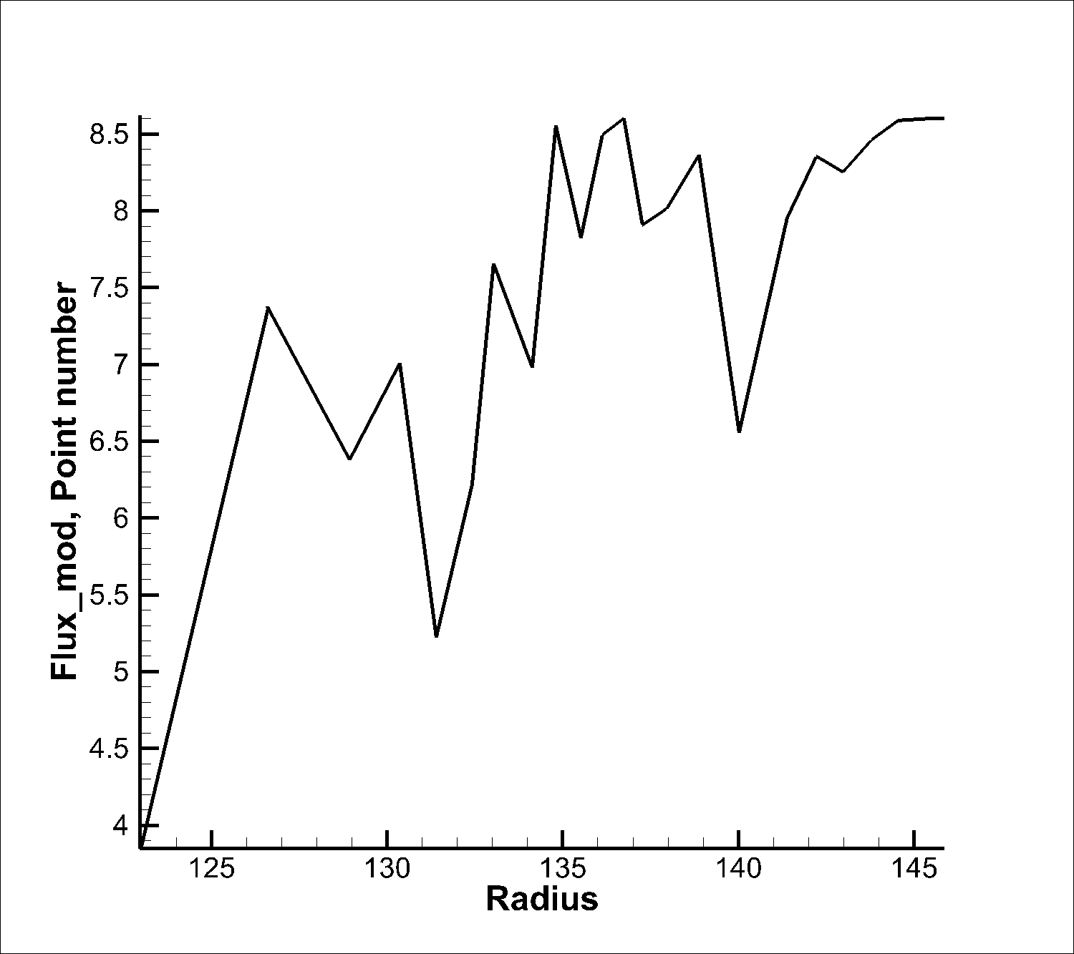
Measured and simulated GCRs with E > 70 MeV
GCRs (predominantly protons)with energies exceeding 70 MeV measured by Voyager 1 (red lines). [From Stone et al., 2013)
Simulations demonstrate that the changes in the GCR flux may be due to instabilities near the heliopause.

Slide 24
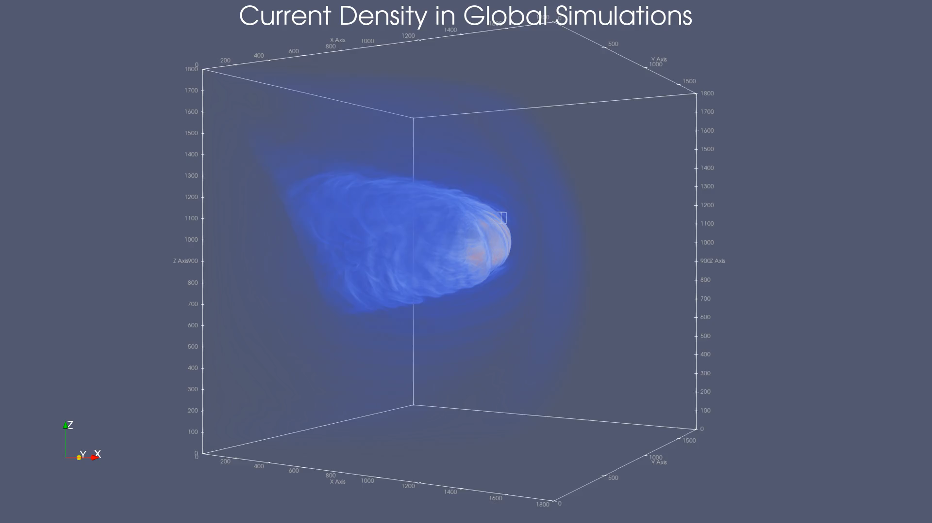
Zoom int the instability/reconnection region.
Hall-MHD simulations of driven turbulence by Grzegorz Kowal.

Slide 25
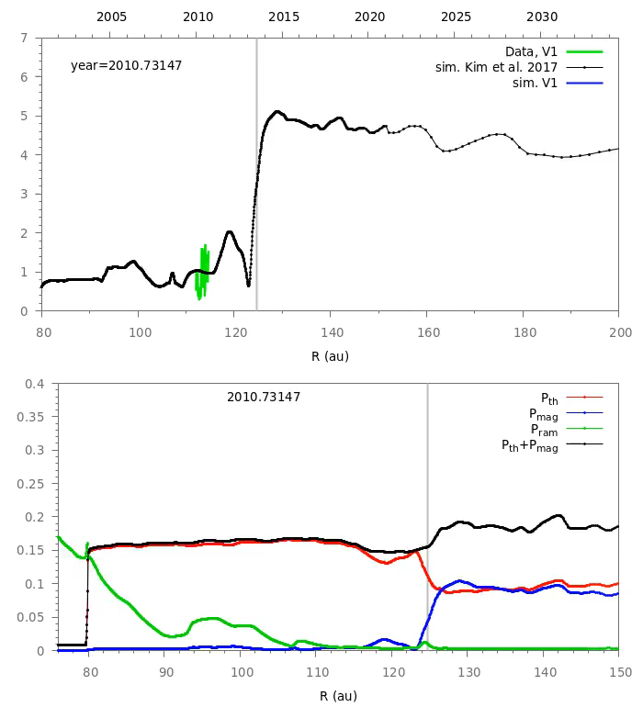
(Top panel) Time evolution of the magnetic field magnitude along the V1 trajectory: data vs 3-D simulations of Kim et al. (2017) extended to 2020.
(Bottom panel) Pressures along the V1 trajectories.
The vertical straight line represents the heliopause.
Notice shock merging. Data-driven simulations show that V1 should start to observe a rather quite flow in the VLISM (see also Burlaga et al., 2020).
Animations from Pogorelov et al. (2021).

Slide 26
Helium in the Heliosphere (in addition to H) (Fraternale et al., 2021)

Slide 27
Something I did not talk about.
We extended our model by
treating pickup ions as a separate fluid with the kinetically-derived boundary conditions for them at the heliospheric termination shock and
treating electrons as separate fluid with e-p collisions taken into account.

Slide 28
Conclusions
The heliosphere plays an important role in the modulation of the cosmic ray transport, even at energies of TeV and higher. However, this effect is not restricted to the heliosphere itself. On the contrary, it is largely due to the modifications the heliosphere makes to the LISM, essentially creating a Very Local Interstellar Medium (VLISM).
The observed anisotropy of high-energy GCRs imposes restrictions on (i) the structure of the SW-LISM interaction and (ii) on the properties of the LISM. In particular, one might expect that the implied large-scale spatial nonuniformity of the LISM flow will be identifiable in the CR anisotropy data.

